Slide 1
Check up
Change to Exponential Form
1)
2)
3)

Slide 2
Check up 2
Change to equivalent logarithmic form:
3)
5)

Slide 3
Check up 3
Evaluate without a calculator
5)
6)

Slide 4
Check up 4
What base does the logarithm have?
9) ln 5
10) Log 16

Slide 5
Check up 5
Find the domain
11) f(x) = log (2 – x)

Slide 7
Chapter 9 Section 4
Properties of Logarithms
Page 704

Slide 8
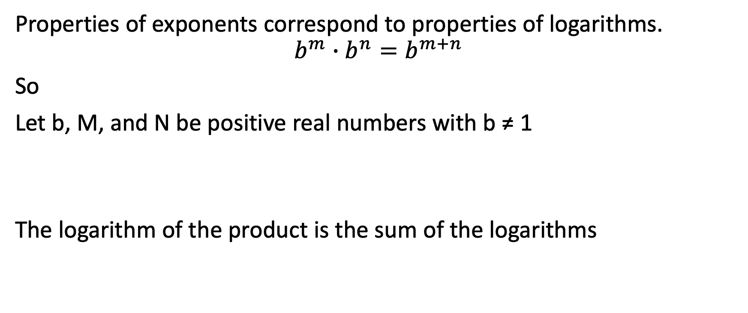
The Product Rule
Properties of exponents correspond to properties of logarithms.
$$b^{m}∙b^{n}=b^{m+n}$$
So
Let b, M, and N be positive real numbers with b ≠ 1
The logarithm of the product is the sum of the logarithms

Slide 9
Expanding a Logarithmic Expression
Write a logarithm with more than one logarithm
Example:
Expanded:

Slide 10
Expand the following
b) log(100x)

Slide 11
Condensing Logarithmic Expressions
Write the logarithm as a single logarithmic expression
Example:
Condense the following:
•
Solution:
• Use the product rule

Slide 12
Condense
log₇ 19 + log ₇ 5
ln 7 + ln x

Slide 13
Quotient Rule
Same Base:
Let b, M, and N be positive real numbers with b ≠ 1
The logarithm of a quotient is the difference of the logarithms.

Slide 14
Example
Expand the logarithm
Solution:
Simplify
5 – ln 11

Slide 15
Expand the following
a)
b)

Slide 16
Condense the following:
log ₇ 19 – log ₇ x
ln e³ – ln 7

Slide 17
The Power Rule
Exponential Expression is raised to a power, multiply the exponents.
The Power Rule
Let b, M, and N be positive real numbers with b ≠ 1 and p any real number

Slide 18
Example
Expand the logarithm
Solution:
power becomes the coefficient.
b) Expand:
Solution:
5 log(4x)

Slide 19
Review
Expand the following:
a)
b)
c)

Slide 20
Condensing Logarithmic Expressions
Write the logarithm as a single logarithmic expression
Example:
Condense the following:
•
Solution:
• Use the product rule

Slide 21
Write as a single logarithm - Condense
log 25 + log 4
b)
c) 2 log (x – 3) – log x

Slide 22
The Change-of Base Property
Calculators give values of both common logarithms and natural logarithms. To find the value of any other base, this property is used.
For any logarithmic bases ‘a’ and ‘b’, and any positive numbers M,

Slide 23
Example
Evaluate:
Solution: Since the calculator can only evaluate logarithms with base 10 and base ‘e’, pick the base
Base 10 Base e
Use the calculator and evaluate the quotient.

Slide 24
Try
Evaluate. Give the answer to 3 decimal places.
a)
b) log₆₃ 17

Slide 25
Natural logarithms
The rules hold for the natural logarithm.

Slide 26
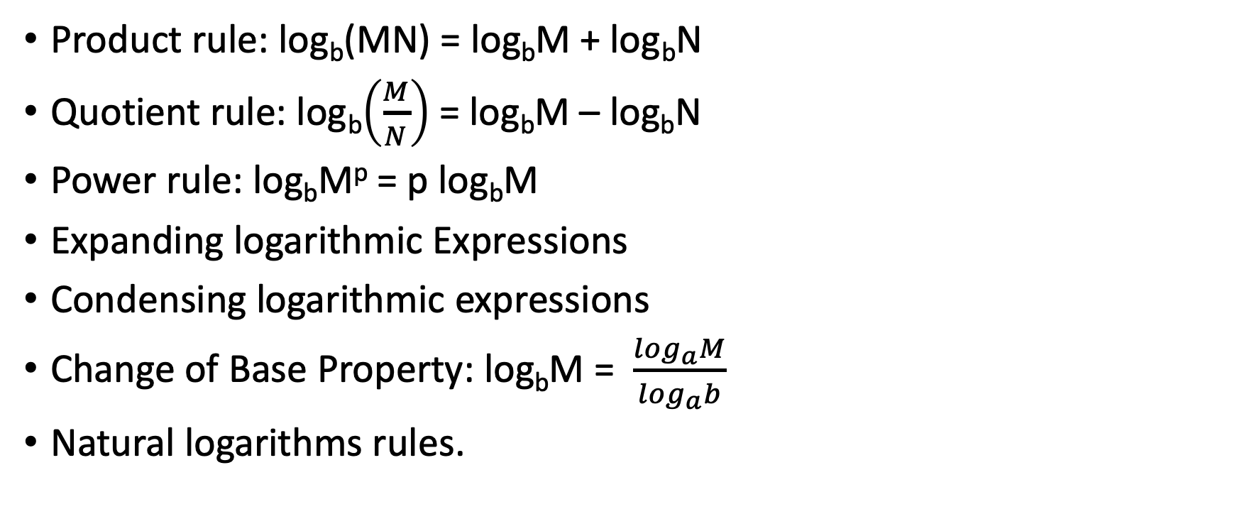
Summary
Product rule: log_{b}(MN) = log_{b}M + log_{b}N
Quotient rule: log_{b}$\left(\frac{M}{N}\right)$ = log_{b}M – log_{b}N
Power rule: log_{b}M^{p} = p log_{b}M
Expanding logarithmic Expressions
Condensing logarithmic expressions
Change of Base Property: log_{b}M = $\frac{\log_{a}M}{\log_{a}b}$
Natural logarithms rules.

