Slide 1
Chapter 9 Section 2
Composite and Inverse Functions
Page 676

Slide 2

Warm up
If f(x) = 3x – 2 find f(4).
If g(x) = $2x^{2}+7x−6$ , find g(3)

Slide 3
Composite Functions
Rewrite two functions as one.
Notation: composite function
the composition of the function f with g.
This is read, f of g of x
x is in the domain of g
g(x) is in the domain of f

Slide 4
Example
f(x) = x – 300, g(x) = 0.85x find
Solution:
Since is the same as f(g(x))
Replace g(x) with 0.85x
f(0.85x)
So f(0.85x) = 0.85x – 300
Then write the answer: =0.85x - 300

Slide 5
Form a Composite Function
Given: f(x) = 3x – 4 and g(x) =
Find and g(f(x))

Slide 6

One More
Find ($g∘f)$ (x) if f(x) = 2x and g(x) = x + 7

Slide 7
Inverse Functions
Notation:
Definition: Let ‘f ‘and ‘g’ be two functions such that
f(g(x)) = x for every x in the domain of g
g(f(x)) = x for every x in the domain of f
Function ‘g’ is the inverse of the function ‘f’
read ’f inverse’.

Slide 8
Verify Inverse Functions
f(x) = 5x and g(x) =
To verify that f(x) and g(x) are inverses, show that
f(g(x) = x and g(f(x)) = x

Slide 9
Find the Inverse of a Function
Replace f(x) with ‘y’ in the equation.
Interchange ‘x’ and ‘y’
Solve for ‘y’
If the function does not have an inverse, stop.
4) If ‘f’ has an inverse, then replace ‘y’ with

Slide 10

Find the inverse
f(x) = 2x + 3
f(x) = $x^{3}−1$

Slide 11
Horizontal Line Test and One-to—One Functions
A function ‘f’ has an inverse that is a function, , if there is no horizontal line that interests the graph of the function ‘f’ at more than one point.
If the function passes the horizontal line test, the function is call a one-to-one function.

Slide 12
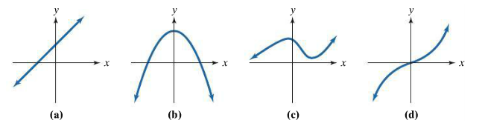
Which graph passes the Horizontal Line Test?
a, b, c, d ?

Slide 13
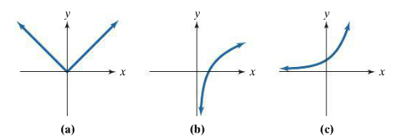
Which graphs represent functions that have inverse function?
Explain how you know.

Slide 14
Summary
Composite functions.
Inverse functions.
Horizontal line test.

