Slide 1
Check up
Simplify Completely the following:
1)
2)

Slide 2
Check up 2
Rationalize the Denominator
3)
4)

Slide 3

Check up 3
Solve the equation:
5) $3x − \sqrt{3x+7}=−5$
6) ${\left(3x −6\right)}^{\frac{1}{3}}$ + 5 = 8

Slide 5
Chapter 9 Section 1
Exponential Functions
Page 662

Slide 6
Definitions
Exponential Function f with base b
f(x) = or y =
Where b is a positive constant other than 1 (b > 0 and b ≠ 1) and x is any read number
Example:
Note: Variable is an exponent.

Slide 7
Simple Definition
Exponential Function has a exponent as a fraction.
Note: Exponent ial Function has the word, ‘exponent’.

Slide 8
Evaluate an Exponential Function
Evaluate:
Solution:
What is available for you to evaluate?
Calculator
Problems?
Go ahead and find the value of f(x)

Slide 9
Find the approximate value
2)
3)

Slide 10
Graphing Exponential Functions
Set up a table of values
Graph:

Slide 11
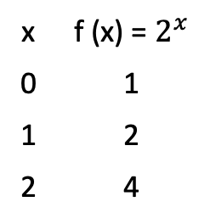
Graph:
Table:
Enough values to find the
shape of the graph ?
x | f (x) = $2^{x}$
0 | 1
1 | 2
2 | 4

Slide 12
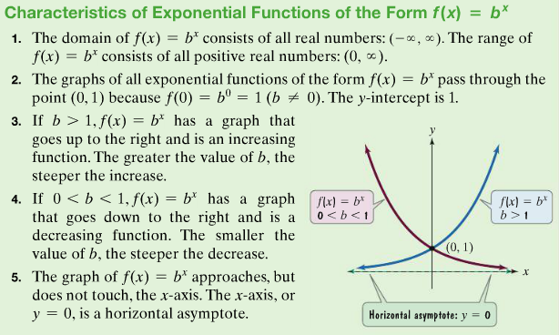
Characteristics of Exponential Functions
Page 666

Slide 13
The Natural Base e
An irrational number, symbolized by the letter, e, appears as a base in many applied exponential function.
The number e is defined as the value that approaches as ’n’ get larger and larger.
The approximate value of ‘e’ is e = 2.718281827
Function, is called the natural exponential function.
e is called the natural base.

Slide 14

Example
Evaluate:
f(x) = 1145$e^{0.025x}$ for x = 36

Slide 15
Compound Interest
*
P: principal, t years at interest rate ‘r’ , compounded annually
Semi annual, quarterly
n compounding periods per year:
Continuous compounding:

Slide 16
Investment
Find the values of $500 after 10 years, interest rate 6.5% compounded semiannually.
2) Same amount, time, rate but compounded continuously.

Slide 17
Summary
Definition of Exponential function..
Find approximate value of an exponential function.
Graph the exponential function.
Natural base ‘e’
Interest formulas
  Compound
  continuously

