Slide 1
Check up
Find the first three terms whose nth term is:
Expand and evaluate:

Slide 2
Check up 2
3) Find the first three terms if the first term is = 300 and the common difference is -5
4) Find the common difference for the sequence: 3, 8, 13, 18, . . .
Find the sum of the first 15 terms of the arithmetic sequence:
4, 10, 16, 22, . . .

Slide 4
Chapter 11 Section 3
Geometric Sequences and Series
Page 842

Slide 5
Definition
Geometric Sequence: sequence in which each term after the first is obtained by multiplying the preceding term by a fixed nonzero constant called the common ratio.

Slide 6
Example
Geometric Sequence
1, 5, 25, 125, 625, . . .
4, 8, 16, 32, 64, . . .
6, - 12, 24, - 48, 96, . . .
Common Ratio
r = = 5
r = = 2
r = = -2

Slide 7

Common Ratio
a₁, a₂, a₃, a₄, . . . a _{n-1}, a _{n}, . . .
r = $\frac{a_{n}}{a_{n−1}}$

Slide 8
Common Ratio
1, 5, 25, 125, 625, . . .
Another way to find the common ration is to ask yourself, what number do I multiply the previous number to get the next number?

Slide 9
Try
Given the first term as 3 and the common ratio as 6, write the first five terms of the sequence.

Slide 10
Observe
3, 12, 48, 192, 768, . . . . N
term 1 2 3 4 5 n
3( ) 3(4)
What do you notice about the term number and the exponent?
What is the common ratio?

Slide 11
General Term of a Geometric Sequence
The nth term (general term) of a geometric sequence with the first term, and the common ratio, r is

Slide 12
Find the eighths term
First term is - 4 and the common ration is 5.
Solution: Use the formula:
= -4, r = 5, n = 8

Slide 13
Sum of Terms
Sum of the first ‘n’ terms of an geometric sequence, and called the nth partial sum.

Slide 14
Find the sum of the first 10 terms
2, 6, 18, 54, . . .
Solution: Use the formula:
Find , r, n.
is the first term, 2
r common ratio: = 3
n number of terms, 10, so
simplify

Slide 15
Sum of an Infinite Geometric Series
Will have a sum if -1 < r < 1 or | r|< 1
That sum will be:

Slide 16
Determine if the following has a sum
3, 6, 12, 24, . . .

Slide 17
Series or sequence
Sequence – numbers that follow a certain rule
Series – sum of the sequence

Slide 18
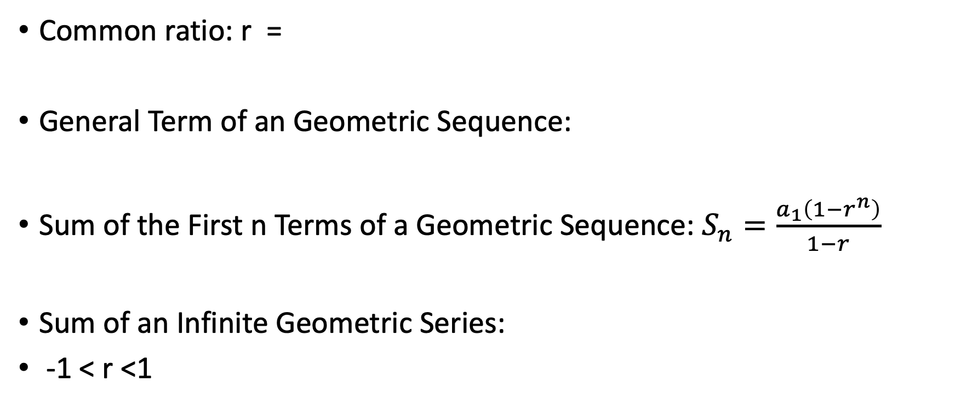
Useful Formulas in this section
Common ratio: r =
General Term of an Geometric Sequence:
Sum of the First n Terms of a Geometric Sequence: $S_{n}=\frac{a_{1}\left(1−r^{n}\right)}{1−r}$
Sum of an Infinite Geometric Series:
-1 < r <1

Slide 19
Summary
Common ratio
General term
Sum
  First n terms
  Infinite series

