Slide 1

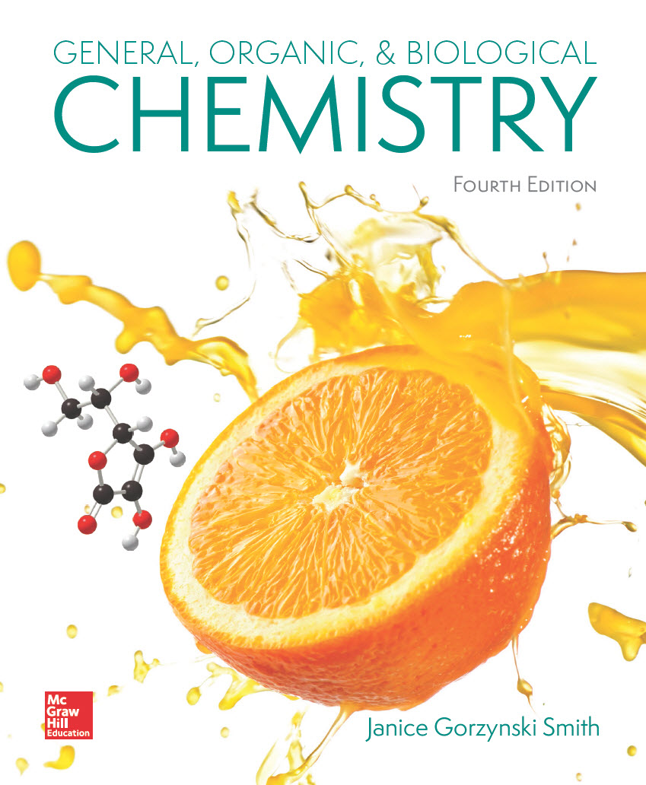
Chapter 19
Lecture Outline
Prepared by
Harpreet Malhotra
Florida State College at Jacksonville

Slide 2
19.1 Introduction to Lipids (1)
Lipids are biomolecules that are soluble in organic solvents and insoluble in water.
They are defined by a physical property, and not by the presence of a particular functional group.
They contain many nonpolar C—C and C—H bonds and few polar bonds resulting in their water insolubility.

Slide 3
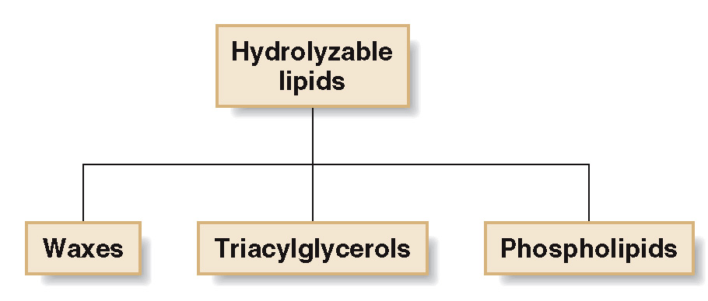
19.1 Introduction to Lipids (2)
Lipids can be categorized as:
Hydrolyzable lipids can be converted into smaller molecules by hydrolysis.

Slide 4
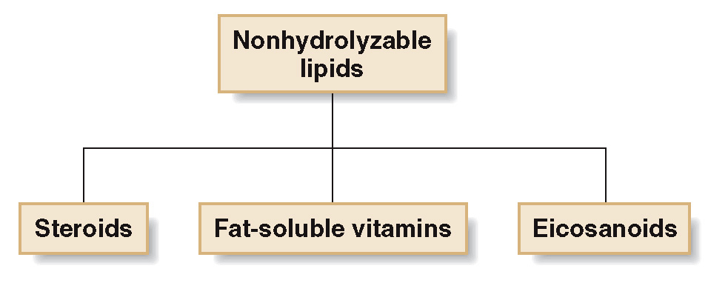
19.1 Introduction to Lipids (3)
Lipids can be categorized as:
Nonhydrolyzable lipids cannot be cleaved into
smaller molecules by aqueous hydrolysis.

Slide 5
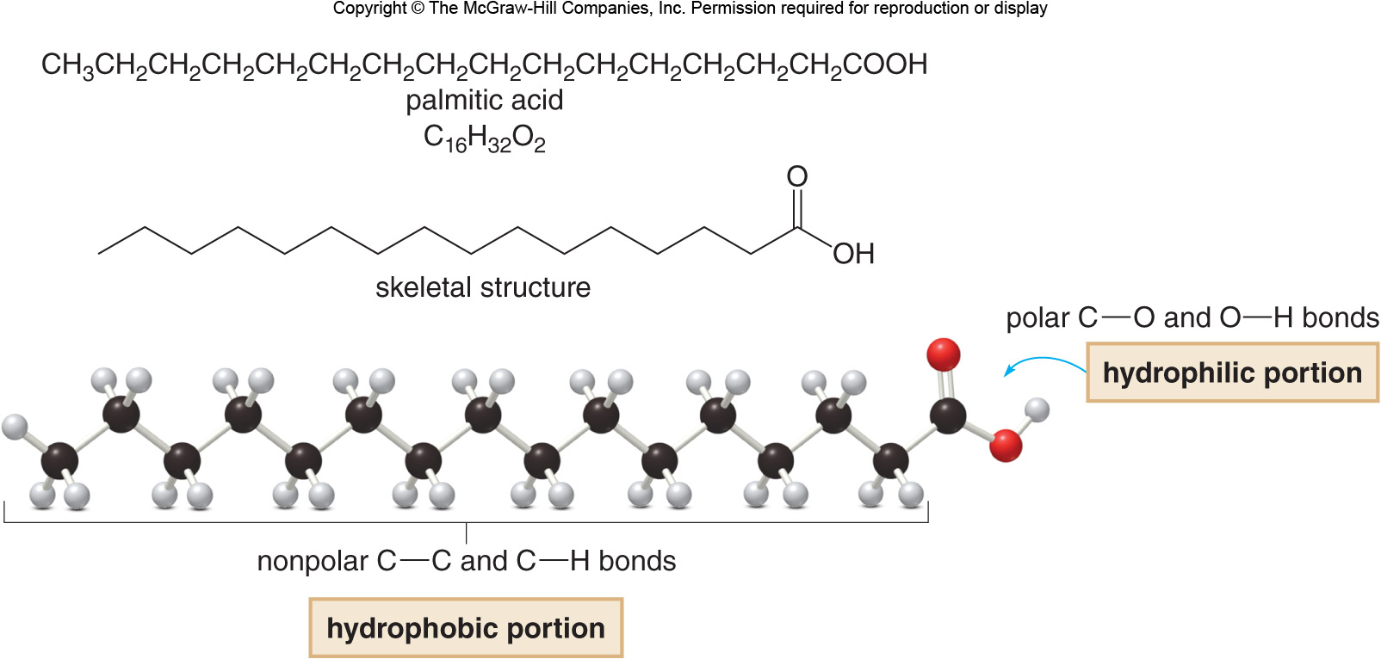
19.2 Fatty Acids (1)
Hydrolyzable lipids are derived from fatty acids.
Fatty acids are carboxylic acids (RCOOH) with long carbon chains of 12 to 20 C atoms.

Slide 6
19.2 Fatty Acids (2)
Naturally occurring fatty acids have an even number of C atoms.
Saturated fatty acids have no double bonds in their long hydrocarbon chains.
Unsaturated fatty acids have 1 or more double bonds (generally cis) in their long hydrocarbon chains.
As the number of double bonds in the fatty acid increases, the melting point decreases.

Slide 7
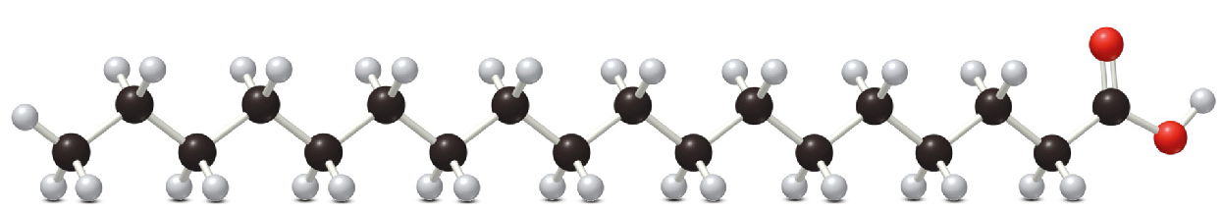
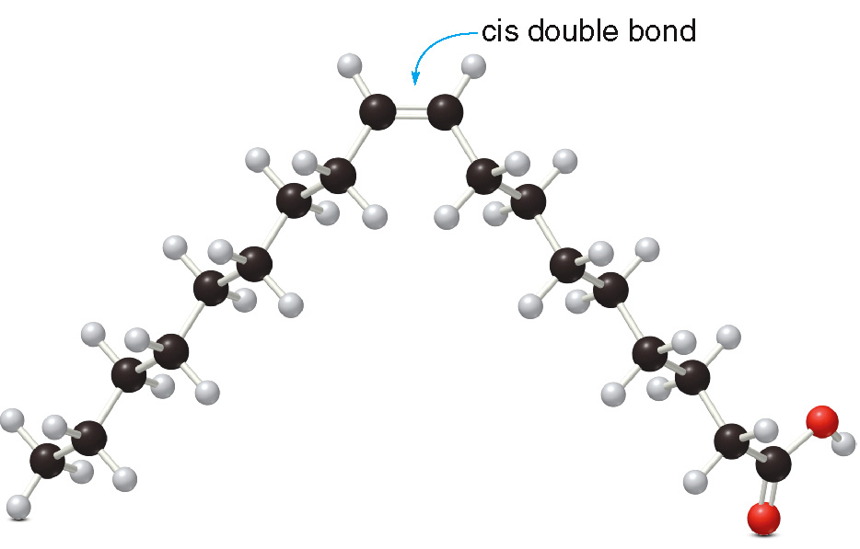
19.2 Fatty Acids (3)
Stearic acid
is a saturated fatty acid.
Oleic acid
is an unsaturated fatty acid.

Slide 8
19.2 Fatty Acids (4)
Table 19.2 Common Fatty Acids
Number of C’s
Number of C=C’s
Structure
Name
Saturated Fatty Acids
12
0
CH₃(CH₂)₁₀COOH
Lauric acid
44
14
0
CH₃(CH₂)₁₂COOH
Myristic acid
58
16
0
CH₃(CH₂)₁₄COOH
Palmitic acid
63
18
0
CH₃(CH₂)₁₆COOH
Stearic acid
71
20
0
CH₃(CH₂)₁₈COOH
Arachidic acid
77
Unsaturated Fatty Acids
16
1
CH₃(CH₂)₅CH = CH(CH₂)₇COOH
Palmitoleic acid
1
18
1
CH₃(CH₂)₇CH = CH(CH₂)₇COOH
Oleic acid
16
18
2
CH₃(CH₂)₄CH = CHCH₂CH = CH(CH₂)₇COOH
Linoleic acid
−5
18
3
CH₃CH₂CH = CHCH₂CH = CHCH₂CH = CH(CH₂)₇COOH
Linolenic acid
−11
20
4
CH₃(CH₂)₄(CH = CHCH₂)₄(CH₂)₂COOH
Arachidonic acid
−49

Slide 9
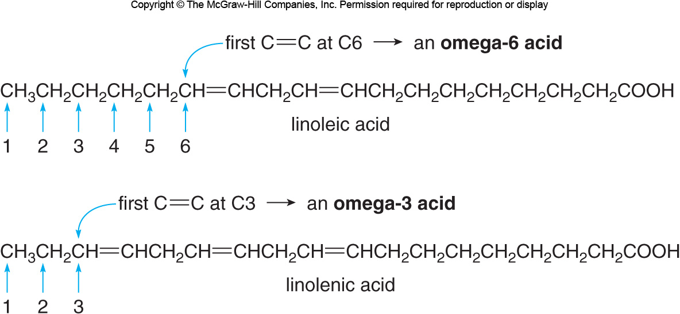
19.2 Fatty Acids (5)
Linoleic acid is called an omega-6 acid, because of the position of the first C=C in the nonpolar chain.
Linolenic acid is called an omega-3 acid, because of the position of the first C=C in the nonpolar chain.

Slide 10
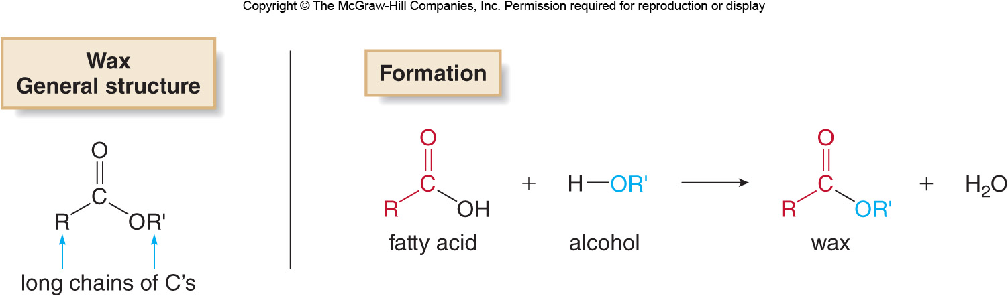
19.3 Waxes (1)
Waxes are esters formed from a fatty acid and a high molecular weight alcohol.

Slide 11
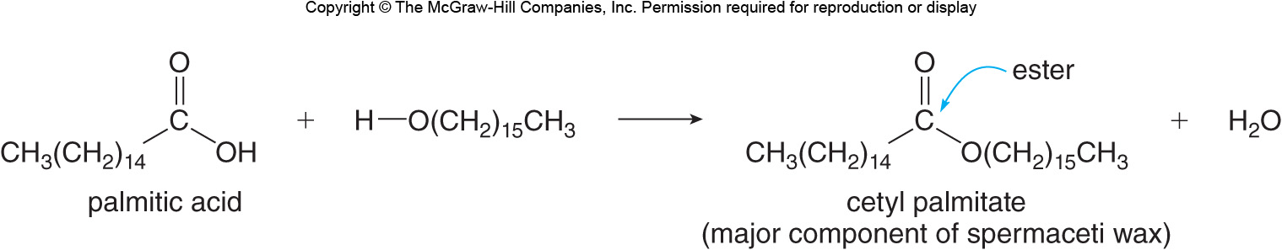
19.3 Waxes (2)
Below is the formation of spermaceti wax, isolated from the heads of sperm whales.

Slide 12
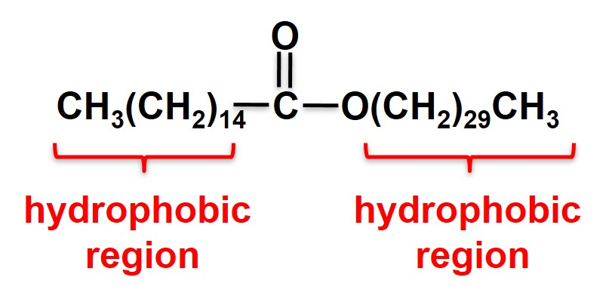
19.3 Waxes (3)
Because of their long nonpolar C chains, waxes are very hydrophobic.
They form protective coatings on bird’s feathers and sheep’s wool and make up beeswax.
Beeswax (myricyl palmitate):

Slide 13
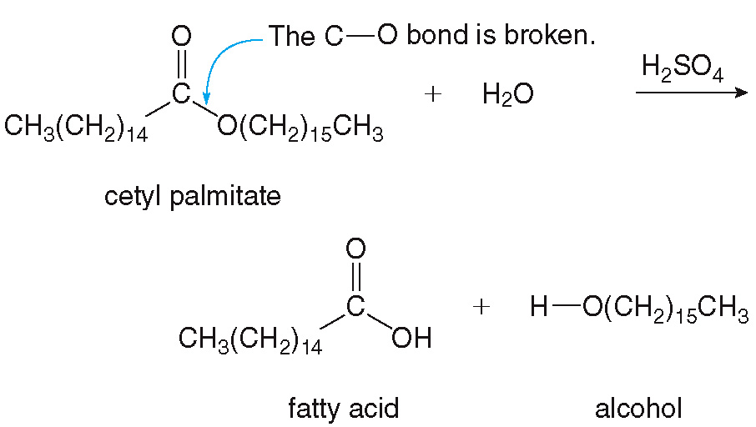
19.3 Waxes (4)
Like other esters, waxes are hydrolyzed with water in the presence of acid or base to re-form the carboxylic acid and alcohol from which they were prepared.

Slide 14
19.4 Triacylglycerols—Fats and Oils (1)
Triacylglycerols (triglycerides) are three esters formed from glycerol and three molecules of fatty acids.
Below is a generalized block diagram of a triacylglycerol:

Slide 15
19.4 Triacylglycerols—Fats and Oils (2)
The general reaction for the formation of a triacylglycerol is:

Slide 16
19.4 Triacylglycerols—Fats and Oils (3)
General Features
Simple triacylglycerols have three identical fatty acid side chains.

Slide 17
19.4 Triacylglycerols—Fats and Oils (4)
General Features
Mixed triacylglycerols have two or three different fatty acids.

Slide 18
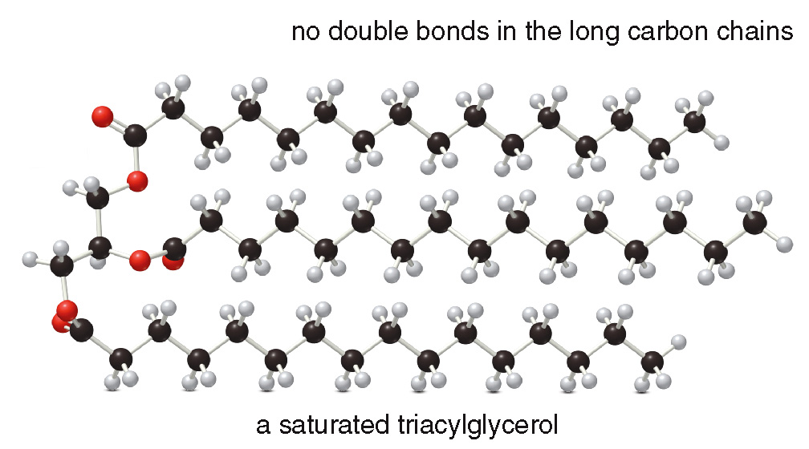
19.4 Triacylglycerols—Fats and Oils (5)
General Features
Saturated triacylglycerols contain only saturated fatty acids; they make up most animal fat and are solids at room temperature.

Slide 19
19.4 Triacylglycerols—Fats and Oils (6)
General Features
Unsaturated triacylglycerols contain at least one unsaturated fatty acid; they make up most vegetable oils and are liquids at room temperature.
Monounsaturated triacylglycerols have 1 C=C bond.
Polyunsaturated triacylglycerols have many C=C bonds.
Increasing the number of double bonds in the fatty acid chain decreases the melting point of the triacylglycerol.

Slide 20
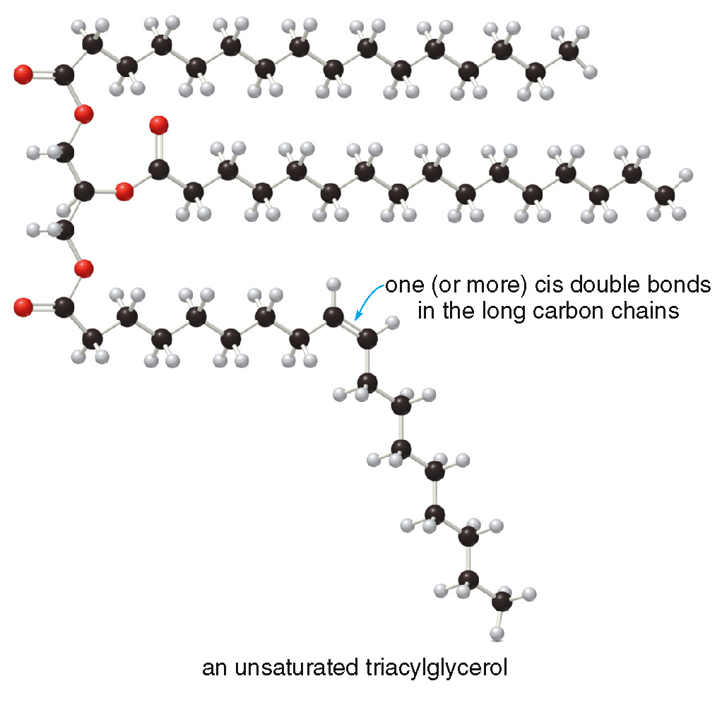
19.4 Triacylglycerols—Fats and Oils (7)
General Features
An unsaturated triacylglycerol:

Slide 21
19.4 Triacylglycerols—Fats and Oils (8)
General Features
Fats have higher melting points; they are solids at room temperature
Fats are derived from fatty acids with few double bonds.
Oils have lower melting points; they are liquids at room temperature.
Oils are derived from fatty acids having a larger number of double bonds.

Slide 22
19.4 Triacylglycerols—Fats and Oils (9)
General Features
Table 19.3 Fatty Acid Composition of Some Fats and Oils
Substance
% Saturated
% Monounsaturated
% Polyunsaturated
Cooking Fat
Lard
39
44
11
1
Butter
60
26
5
5
Shortening
22
29
29
18
Oils
Canola
7
58
29
0
Safflower
9
12
24
0
Sunflower
10
20
66
0
Corn
13
24
60
0
Olive
13
72
8
0
Soybean
16
44
37
0
Peanut
17
49
32
0
Palm
50
37
10
0
Coconut
87
6
2
0
Margarine/Spreads
70% Soybean oil, stick
18
2
29
23
60% Vegetable oil spread
18
22
54
5
double bonds are formed when triacylglycerols are partially hydrogenated, as described in Section 13.7. [Source:
Harvard School of Public Health, but similar data is available from many other sources. ]

Slide 23
19.4 Triacylglycerols—Fats and Oils (10)
Focus on Health and Medicine
Fats are used to build cell membranes, insulate the body, and store energy for later use.
It is recommended that no more than 20 to 35% of a person’s caloric intake should come from lipids.
A high intake of saturated triacylglycerols is linked to heart disease.
Saturated fats stimulate cholesterol synthesis, which can lead to cholesterol plaques building up inside arteries.
The result is high blood pressure, heart attack, and even stroke.

Slide 24
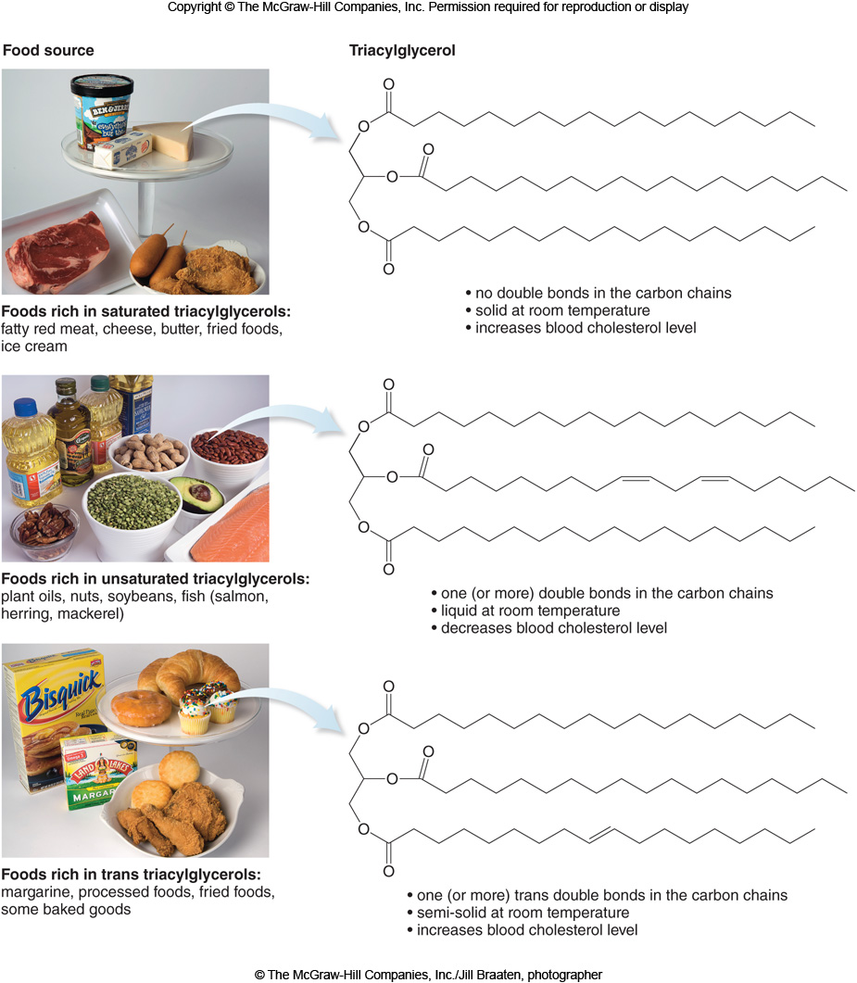
19.4 Triacylglycerols—Fats and Oils (11)
Focus on Health and Medicine
© The McGraw-Hill Companies, Inc./Jill Braaten, photographer

Slide 25
19.4 Triacylglycerols—Fats and Oils (12)
Focus on Health and Medicine
© The McGraw-Hill Companies, Inc./Jill Braaten, photographer

Slide 26
19.4 Triacylglycerols—Fats and Oils (13)
Focus on Health and Medicine
Unsaturated triacylglycerols lower the risk of heart disease by decreasing the level of cholesterol in the blood.
Triacylglycerols formed from omega-3 fatty acids are very helpful in lowering the risk of heart attack.
However, if the double bond of the unsaturated triacylglycerol is trans, the beneficial effect is lost.
Trans fats, which are primarily synthesized instead of naturally occurring, act like saturated fats and increase the cholesterol levels in the blood.

Slide 27
19.5 Hydrolysis of Triacylglycerols (1)
Triacylglycerols are hydrolyzed with water in the presence of acid, base, or enzymes (in the body).

Slide 28
19.5 Hydrolysis of Triacylglycerols (2)
Focus on the Human Body
Humans store energy as triacylglycerols in adipose cells below the surface of the skin, in the breast area, and surrounding internal organs.
The number of adipose cells is constant; weight gained or lost causes them to swell or shrink, but not decrease or increase in number.
To metabolize triacylglycerols for energy, the esters are hydrolyzed by enzymes called lipases.
Complete metabolism of a triacylglycerol yields CO₂, H₂O, and a great deal of energy.

Slide 29
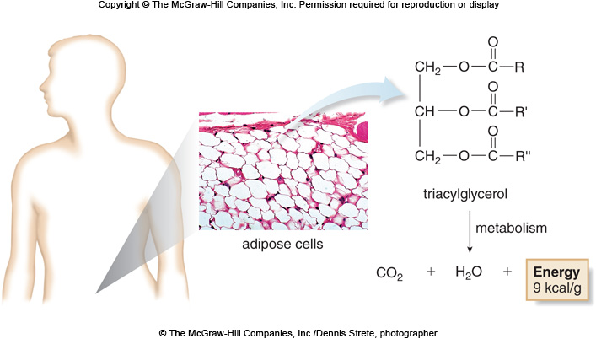
19.5 Hydrolysis of Triacylglycerols (3)
Focus on the Human Body
© The McGraw-Hill Companies, Inc./Dennis Strete, photographer

Slide 30
19.5 Hydrolysis of Triacylglycerols (4)
Soap Synthesis
Soaps are metal salts of fatty acids prepared by basic hydrolysis (saponification) of a triacylglycerol.

Slide 31
19.5 Hydrolysis of Triacylglycerols (5)
Soap Synthesis
(top): ©Image Source/Getty Images RF; (bottom): ©David Buffington/Getty Images RF

Slide 32
19.5 Hydrolysis of Triacylglycerols (6)
Soap Synthesis
The nonpolar tails dissolve grease and oil and the polar head makes it soluble in water.
Soaps are made from lard (from hogs), tallow (from cows or sheep), coconut oil, or palm oil.
All soaps work in the same way, but have different properties depending on the lipid source, length of C chain, and degree of unsaturation.

Slide 33
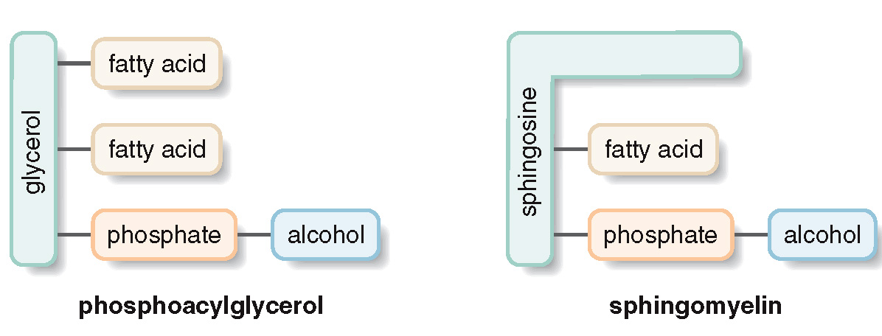
19.6 Phospholipids (1)
Phospholipids are lipids that contain a P atom.
Two common types of phospholipids are phosphoacylglycerols and sphingomyelins.

Slide 34
19.6 Phospholipids (2)
Phosphoacylglycerols
Phosphoacylglycerols are the main component of most cell membranes.
Structurally, they resemble a triacylglycerol with a phosphodiester bonded to an alcohol replacing the third fatty acid.

Slide 35
19.6 Phospholipids (3)
Phosphoacylglycerols
One of the main types of phosphoacylglycerols is cephalin (or phosphatidylethanolamine):

Slide 36
19.6 Phospholipids (4)
Phosphoacylglycerols
The second of the main types of phosphoacylglycerols is lecithin (or phosphatidylcholine):

Slide 37
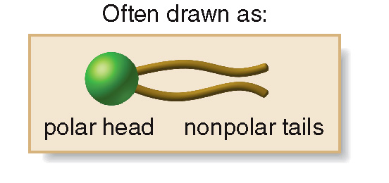
19.6 Phospholipids (5)
Phosphoacylglycerols
The two fatty acid side chains form two nonpolar “tails” that lie parallel to each other.
The phosphodiester end of the molecule is a charged or polar “head”.

Slide 38
19.6 Phospholipids (6)
Phosphoacylglycerols

Slide 39
19.6 Phospholipids (7)
Sphingomyelins
Sphingomyelins do not contain a glycerol backbone, they have a sphingosine
backbone instead.
Sphingomyelins do not contain an ester; their single fatty acid is bonded to the backbone by an amide bond.

Slide 40
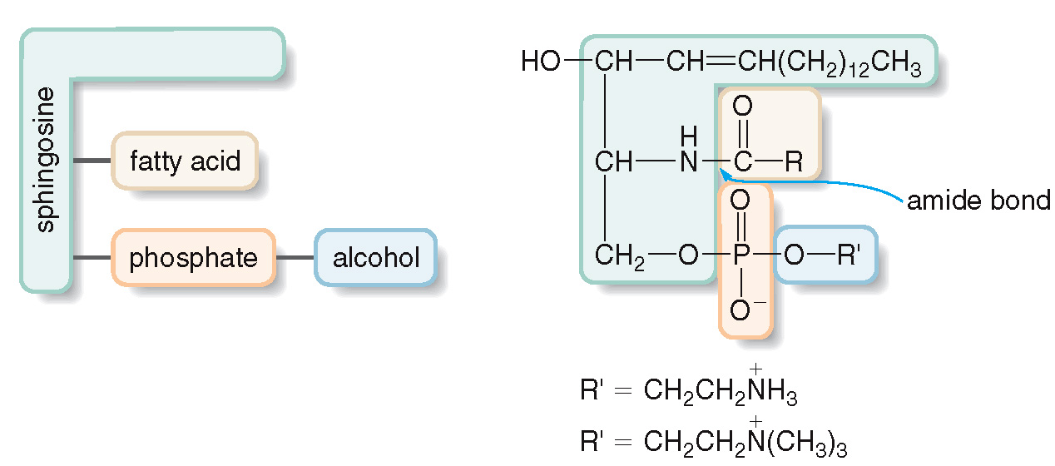
19.6 Phospholipids (8)
Sphingomyelins

Slide 41
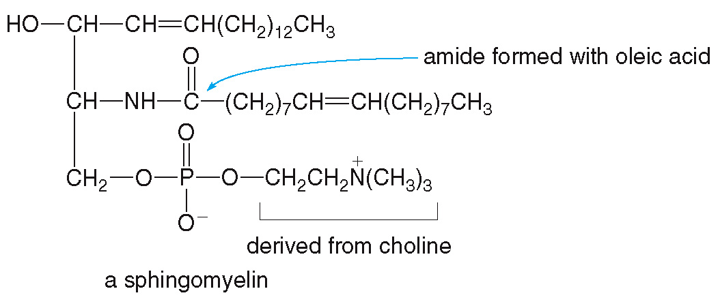
19.6 Phospholipids (9)
Sphingomyelins
An example of sphingomyelin:
The myelin sheath, the coating that surrounds nerve cells, is rich in sphingomyelins.

Slide 42
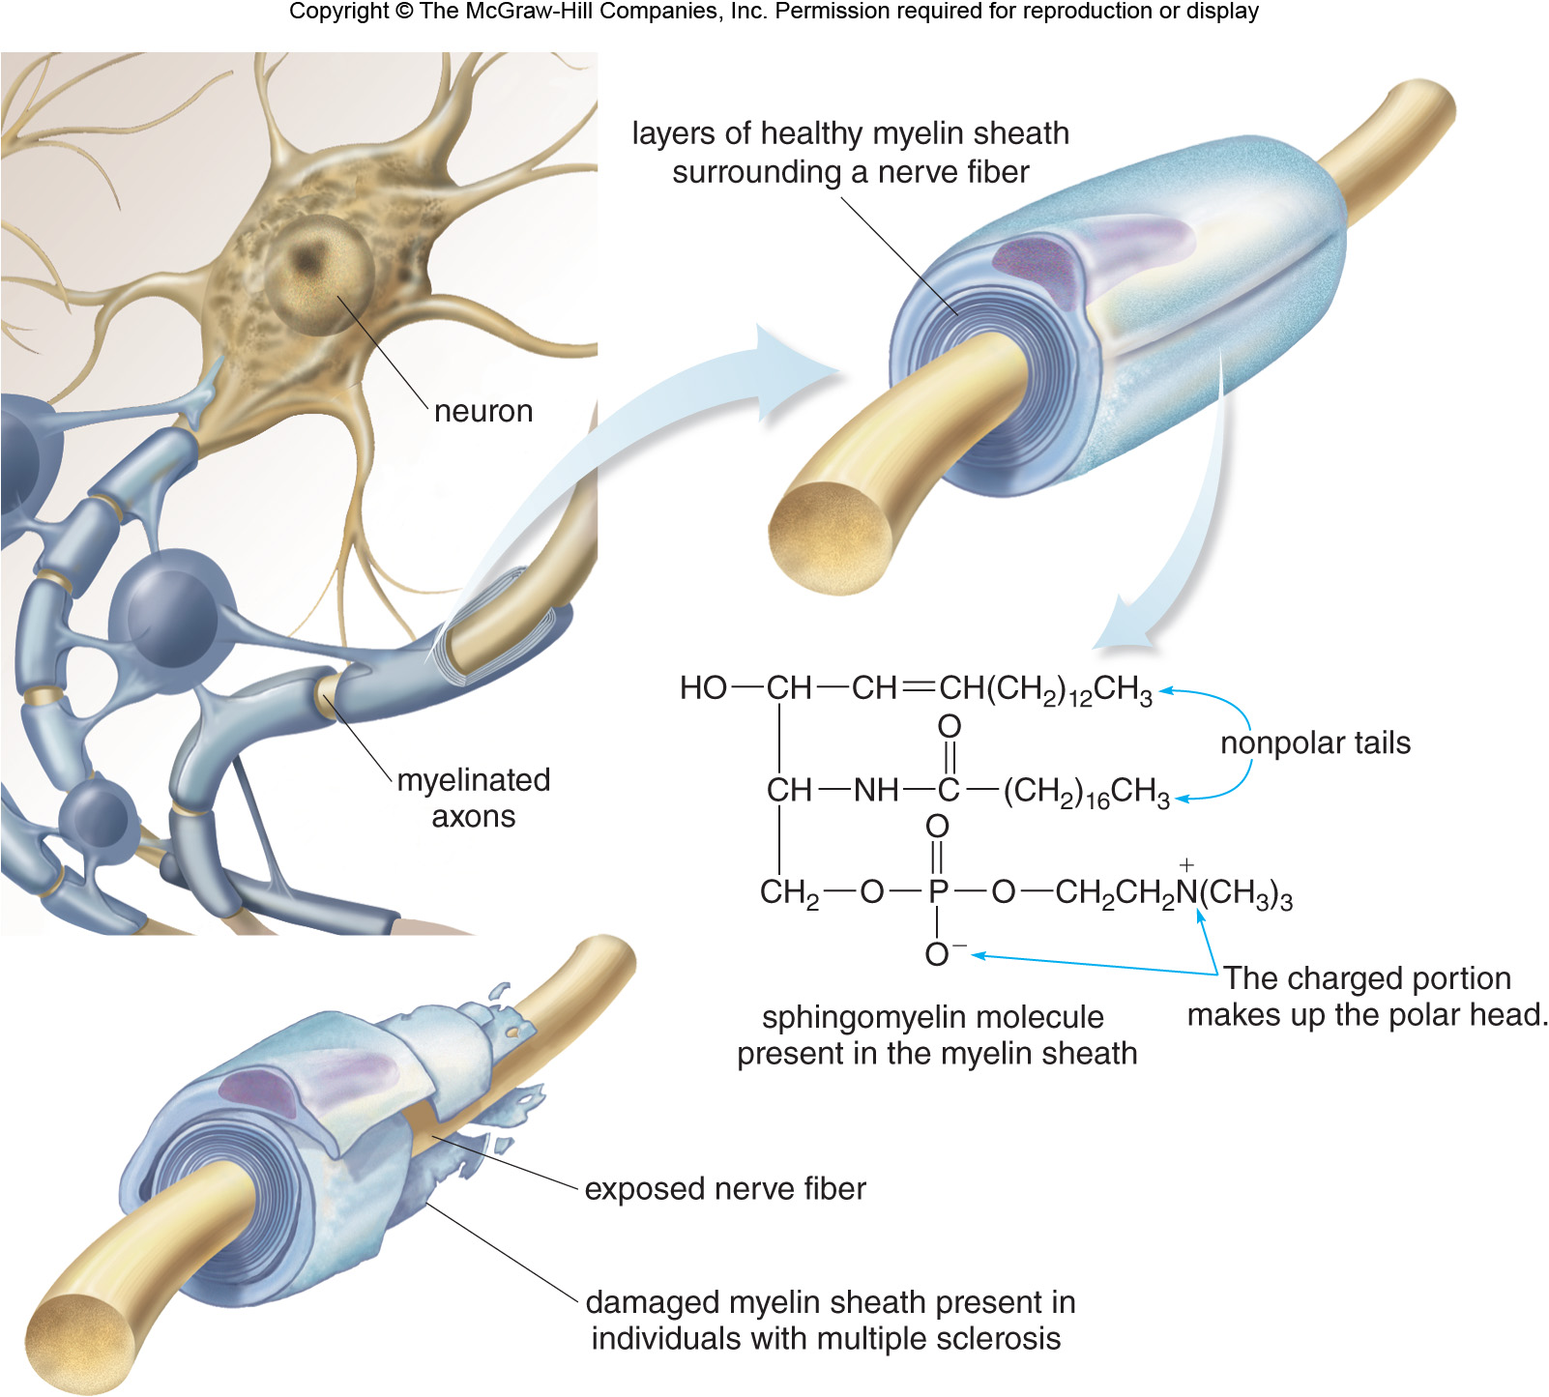
19.6 Phospholipids (10)
Sphingomyelins

Slide 43
19.7 Cell Membranes (1)
Structure of the Cell Membrane
The basic unit of living organisms is the cell.
The cell membrane surrounds the cytoplasm, the aqueous medium inside the cell.
The cell membrane acts as a barrier to stop the passage of ions and molecules into or out of the
cell.
The other job of the membrane is to allow
nutrients in and waste out.
In this way, a cell membrane is selectively permeable.

Slide 44
19.7 Cell Membranes (2)
Structure of the Cell Membrane
Phospholipids, the major component of cell membranes, contain a hydrophilic polar head and two hydrophobic nonpolar tails.
When phospholipids are mixed with water, they assemble into a lipid bilayer.
The polar heads orient on the outside to interact with polar water molecules.
The nonpolar tails orient on the inside to avoid polar water molecules.

Slide 45
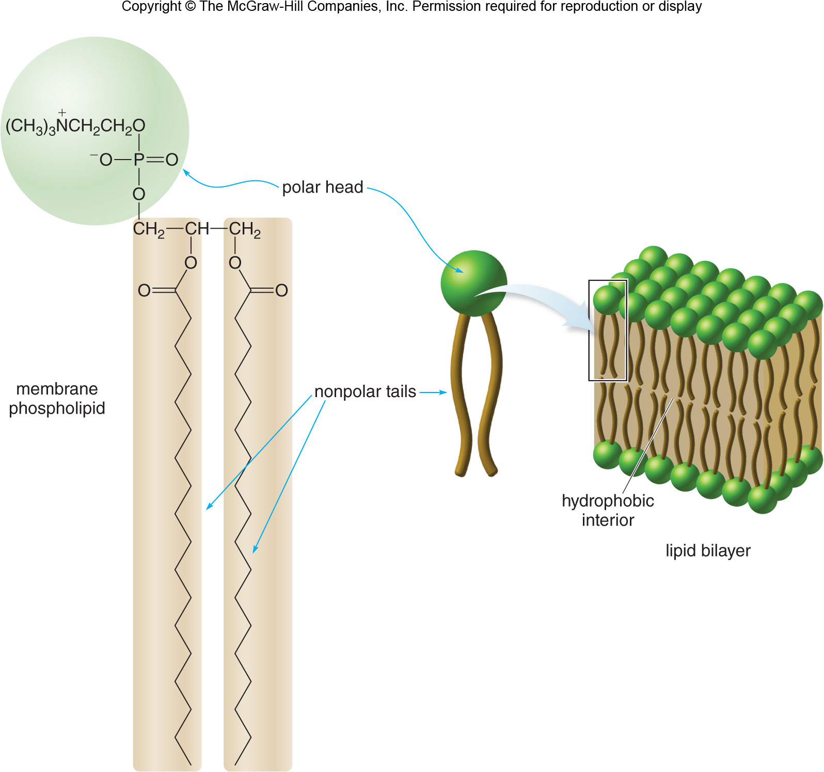
19.7 Cell Membranes (3)
Structure of the Cell Membrane

Slide 46
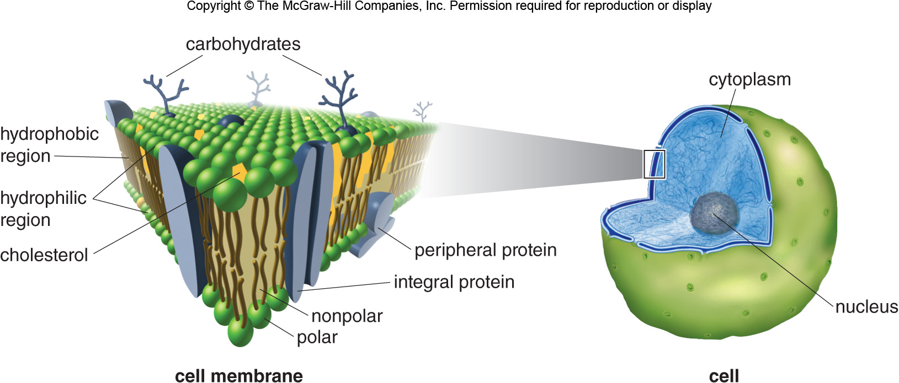
19.7 Cell Membranes (4)
Structure of the Cell Membrane

Slide 47
19.7 Cell Membranes (5)
Structure of the Cell Membrane
Proteins and cholesterol molecules are embedded in the lipid bilayer membrane.
Peripheral proteins are embedded within the membrane and extend outward on one side only.
Integral proteins extend through the entire bilayer.
Sometimes carbohydrates are attached to the exterior of the cell forming glycolipids and glycoproteins.

Slide 48
19.7 Cell Membranes (6)
Transport Across a Cell Membrane
Small molecules like O₂ and CO₂ can diffuse through the cell membrane, traveling from higher to lower concentration.
Larger polar molecules need facilitated transport to cross efficiently.
Ions like
or
travel through integral
protein channels.
Other ions,
and
move against the
concentration gradient; this required energy input and is called active transport.

Slide 49
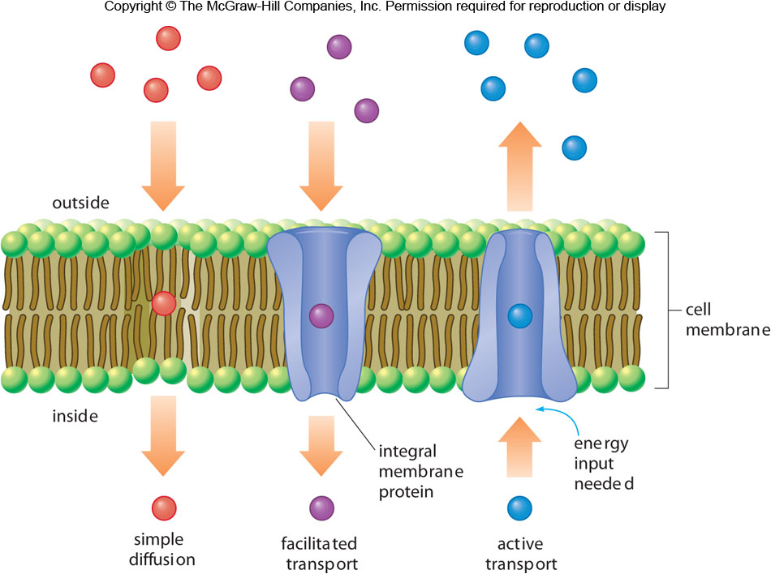
19.7 Cell Membranes (7)
Transport Across a Cell Membrane

Slide 50
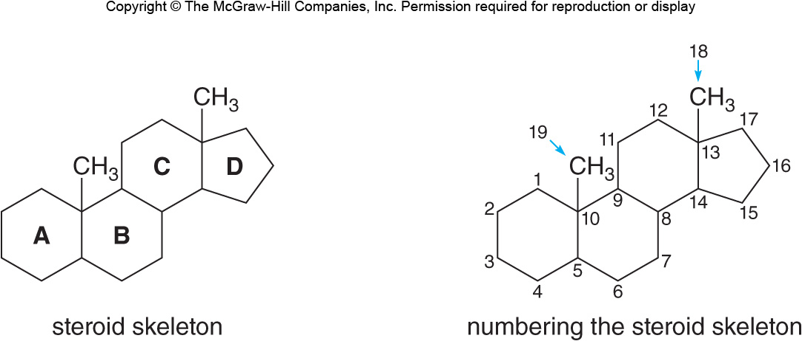
19.8 Focus on Health & Medicine Cholesterol (1)
Steroids are a group of lipids whose carbon skeletons contain several fused rings:

Slide 51
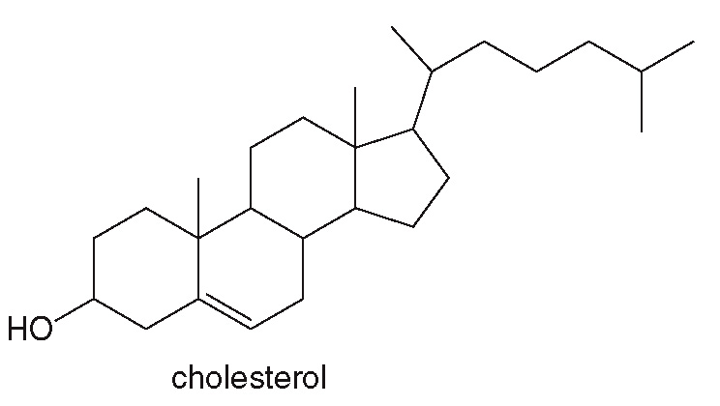
19.8 Focus on Health & Medicine Cholesterol (2)
Cholesterol, the most prominent steroid, is synthesized in the liver and found in almost all body tissues.
It is obtained in the diet from many sources, including meat, cheese, butter, and eggs.

Slide 52
19.8 Focus on Health & Medicine Cholesterol (3)
Elevated levels of cholesterol in the bloodstream lead to coronary artery disease, heart attack, etc.
Cholesterol is insoluble in the aqueous medium of blood.
It is transported through the bloodstream by lipoproteins, aggregates of phospholipids and proteins.
Low-density lipoproteins (LDLs) transport cholesterol from the liver to the tissues.
High-density lipoproteins (HDLs) transport cholesterol from tissues back to the liver.

Slide 53
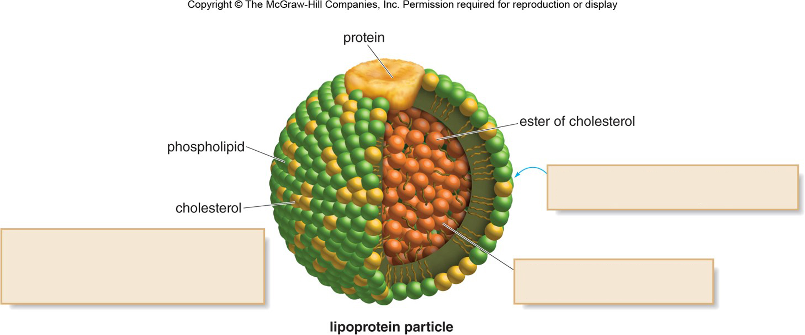
19.8 Focus on Health & Medicine Cholesterol (4)
The surface of the lipoprotein particle contains polar or ionic groups.
Cholesterol is embedded in the phospholipid surface, with the nonpolar carbon skeleton in the interior and the polar OH group pointing outward.
The interior of the lipoprotein particle is hydrophobic

Slide 54
19.8 Focus on Health & Medicine Cholesterol (5)
LDLs deposit cholesterol on the walls of arteries when they carry more than is needed to form cell membranes.
This forms plaque, which restricts blood flow; LDL cholesterol is called “bad” cholesterol.
HDLs reduce the level of cholesterol in the bloodstream by bringing excess back to the liver; HDL cholesterol is called “good” cholesterol.
Recommended levels are: HDL > 40 mg/dL, LDL < 100 mg/dL, total serum cholesterol < 200 mg/dL.

Slide 55
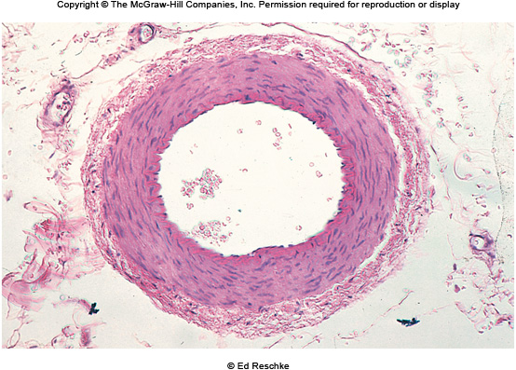
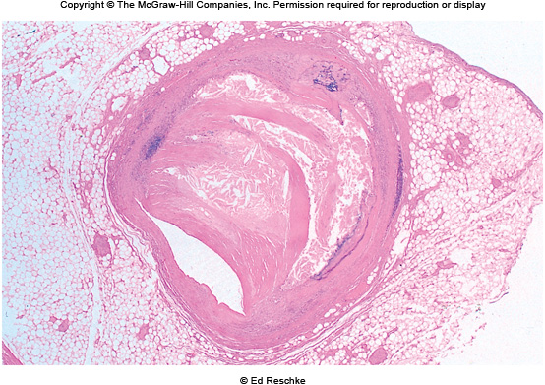
19.8 Focus on Health & Medicine Cholesterol (6)
© Ed Reschke
© Ed Reschke

Slide 56
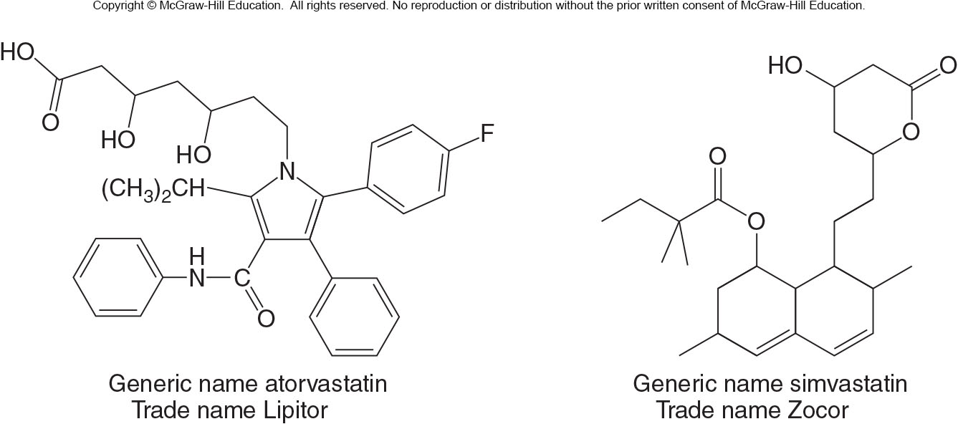
19.8 Focus on Health & Medicine Cholesterol (7)
Drugs called statins reduce the level of cholesterol in the bloodstream.
They act by blocking the synthesis of cholesterol at its early stages.

Slide 57
19.9 Steroid Hormones (1)
A hormone is a molecule that is synthesized in one part of an organism, which then elicits a response at a different site.
Two important classes of steroid hormones include sex hormones and adrenal cortical steroids.
The female sex hormones are estrogens and progestins.
The male sex hormones are called androgens.

Slide 58
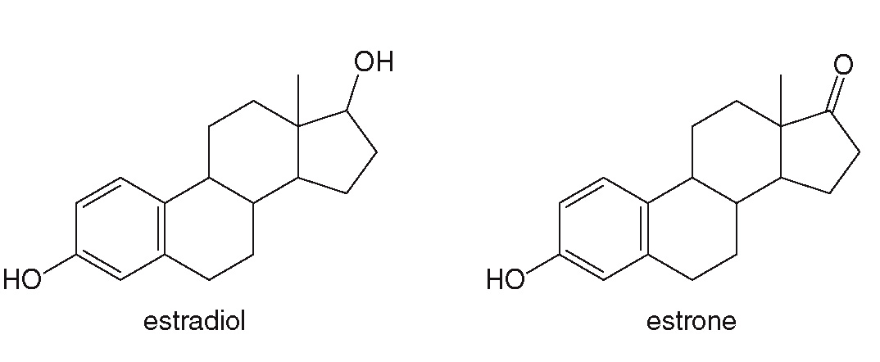
19.9 Steroid Hormones Female Sex Hormones: Estrogens
The estrogens estradiol and estrone control development of secondary sex characteristics, regulate the menstrual cycle, and are made in the ovaries.

Slide 59
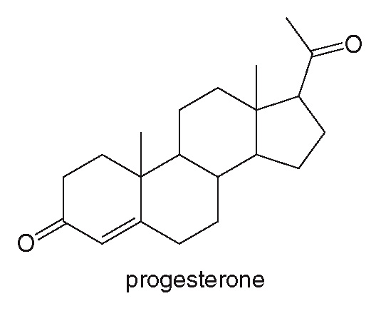
19.9 Steroid Hormones Female Sex Hormones: Progestin
The progestin progesterone is called the “pregnancy hormone”; it is responsible for the preparation of the uterus for implantation of a fertilized egg.

Slide 60
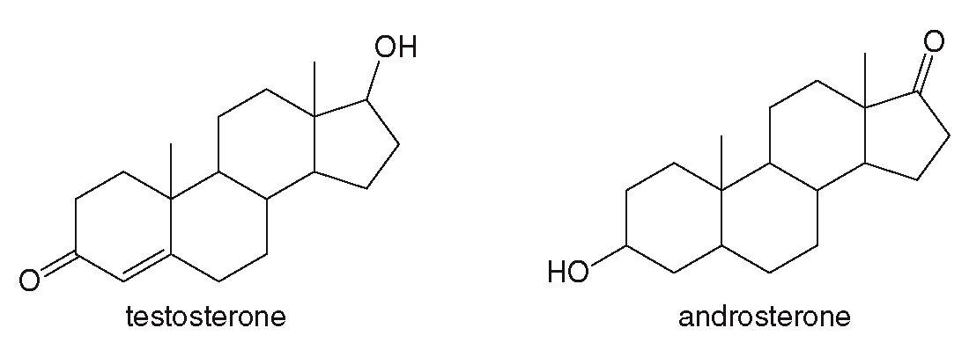
19.9 Steroid Hormones Male Sex Hormones: Androgens
Testosterone and androsterone are androgens made in the testes.
They control the development of secondary sex characteristics in males.

Slide 61
19.9 Steroid Hormones (2)
Synthetic androgen analogues, called anabolic steroids, promote muscle growth.
They have the same effect as testosterone, but are more stable, so they are not metabolized as quickly.
They have come to be used by athletes and body builders, but are not permitted in competitive sports.
Prolonged use of anabolic steroids can cause physical and psychological problems.

Slide 62
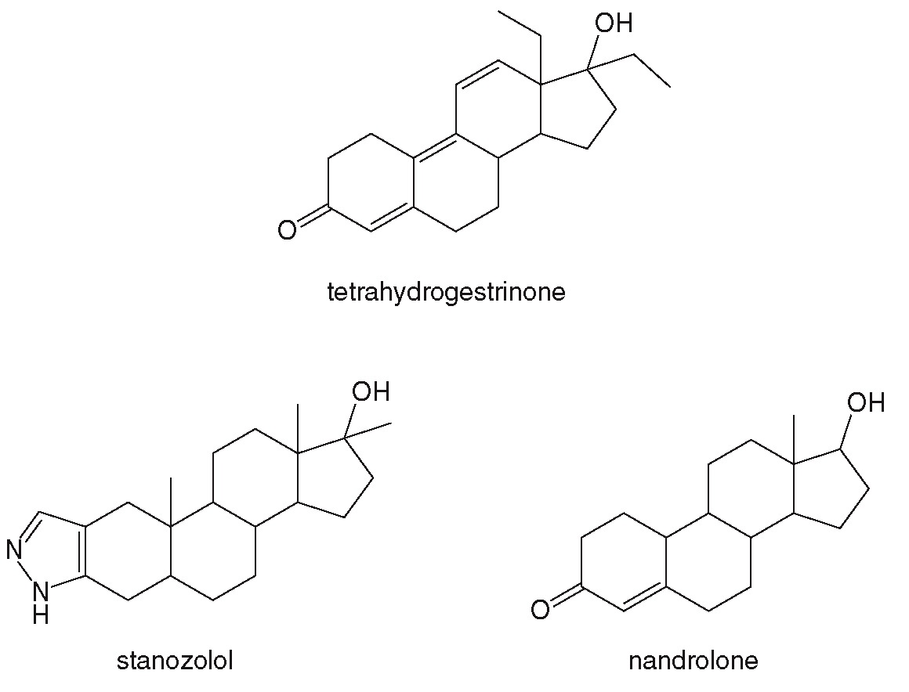
19.9 Steroid Hormones (3)

Slide 63
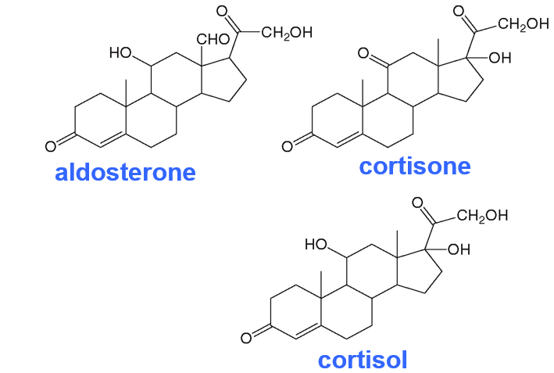
19.9 Steroid Hormones Adrenal Cortical Steroids (1)
Three examples of adrenal cortical steroids are:

Slide 64
19.9 Steroid Hormones Adrenal Cortical Steroids (2)
Aldosterone regulates blood pressure and volume by controlling the concentration of
and
in
body fluids.
Cortisone and cortisol serve as anti-inflammatory agents, which also regulate carbohydrate metabolism.
Prolonged use of these steroids can have undesired side effects, including bone loss and high blood pressure.
Prednisone, a synthetic alternative, has similar anti-inflammatory properties.

Slide 65
19.10 Focus on Health & Medicine Fat-Soluble Vitamins (1)
Vitamins are organic compounds required in small quantities for normal metabolism and must be obtained from the diet.
Vitamins are either water soluble or fat soluble.
The four fat-soluble vitamins (A, D, E, and K) are found in fruits, vegetables, fish, liver, and dairy products.
They are stored in adipose cells to be used when needed.

Slide 66
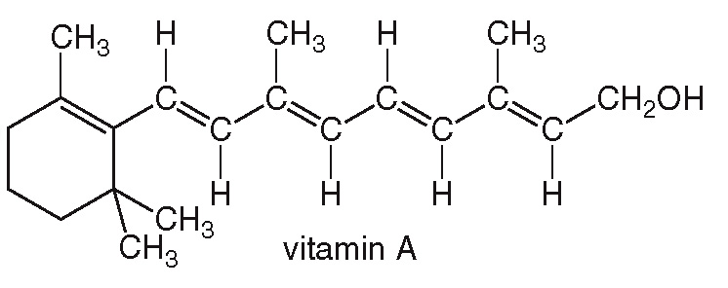
19.10 Focus on Health & Medicine Fat-Soluble Vitamins (2)
Vitamin A is found in liver, fish, and dairy products, and is made from
It is needed for vision and for healthy mucous membranes.
Vitamin A deficiency causes night blindness and dry eyes and skin.

Slide 67
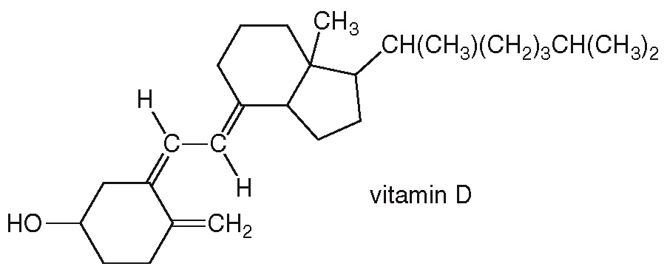
19.10 Focus on Health & Medicine Fat-Soluble Vitamins (3)
Vitamin D can be synthesized from cholesterol.
It can be obtained in the diet from many foods, especially milk, and helps regulate Ca and K metabolism.
A deficiency of vitamin D causes rickets (bone malformation).

Slide 68
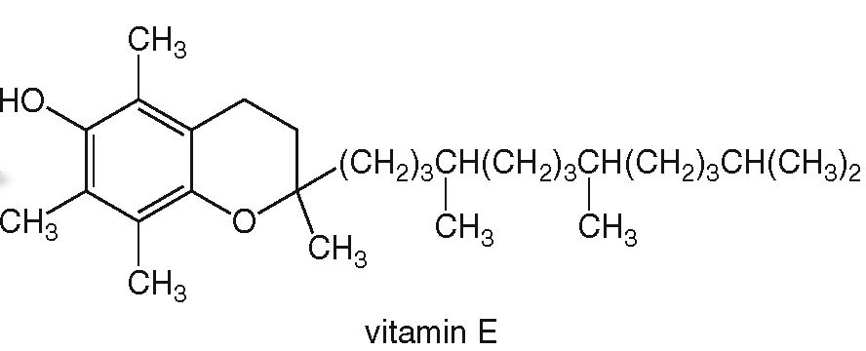
19.10 Focus on Health & Medicine Fat-Soluble Vitamins (4)
Vitamin E is an antioxidant, protecting unsaturated side chains in fatty acids from unwanted oxidation.
Deficiency of vitamin E causes numerous neurological problems, although it is rare.

Slide 69
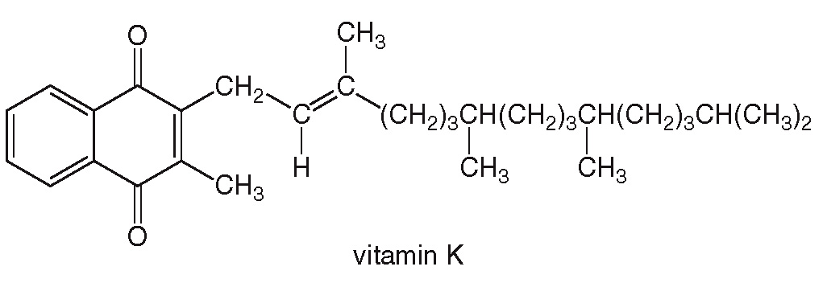
19.10 Focus on Health & Medicine Fat-Soluble Vitamins (5)
Vitamin K regulates the synthesis of clotting proteins (prothrombin), and deficiency of this leads to excessive or fatal bleeding.

Slide 70
19.11 Focus on Health & Medicine Prostaglandins and Leukotrienes
Prostaglandins and leukotrienes are two types of eicosanoids.
All eicosanoids are very potent compounds, which are not stored in cells, but rather synthesized in response to external stimulus.
Unlike hormones they are local mediators, performing their function in the environment in which they are synthesized.

Slide 71
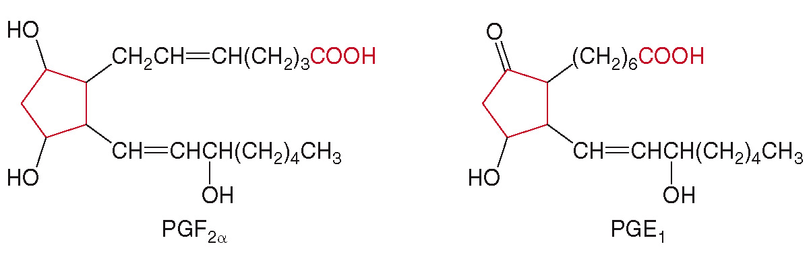
19.11 Focus on Health & Medicine (1)
Prostaglandins
Prostaglandins are carboxylic acids that contain a five-membered ring and have a wide range of biological activities.

Slide 72
19.11 Focus on Health & Medicine (2)
Prostaglandins
Prostaglandins are responsible for inflammation.
Aspirin and ibuprofen relieve pain and inflammation by blocking the synthesis of these molecules.
Prostaglandins also decrease gastric secretions, inhibit blood platelet aggregation, stimulate uterine contractions, and relax smooth muscles.
There are two different cylcooxygenase enzymes responsible for prostaglandin synthesis called COX-1 and COX-2.

Slide 73
19.11 Focus on Health & Medicine (3)
Prostaglandins
COX-1 is involved in the usual production of prostaglandins.
COX-2 is responsible for additional prostaglandins in inflammatory diseases like arthritis.
Nonsteroidal anti-inflammatory drugs (NSAIDs) like aspirin and ibuprofen inactivate both COX-1 and -2, but increase risk for stomach ulcer formation.
Drugs sold as Vioxx, Bextra, and Celebrex block only the COX-2 enzyme without affecting gastric secretions.

Slide 74
19.12 Focus on Health & Medicine (4)
Asthma and Leukotrienes
Asthma is characterized by chronic inflammation, so inhaled steroids to reduce this inflammation are commonly used.
Leukotrienes are molecules that contribute to the asthmatic response by constricting smooth muscle of the lung.
New asthma drugs act by blocking the synthesis of leukotriene
, which treats the disease instead of
just the inflammation symptoms.

