Slide 1

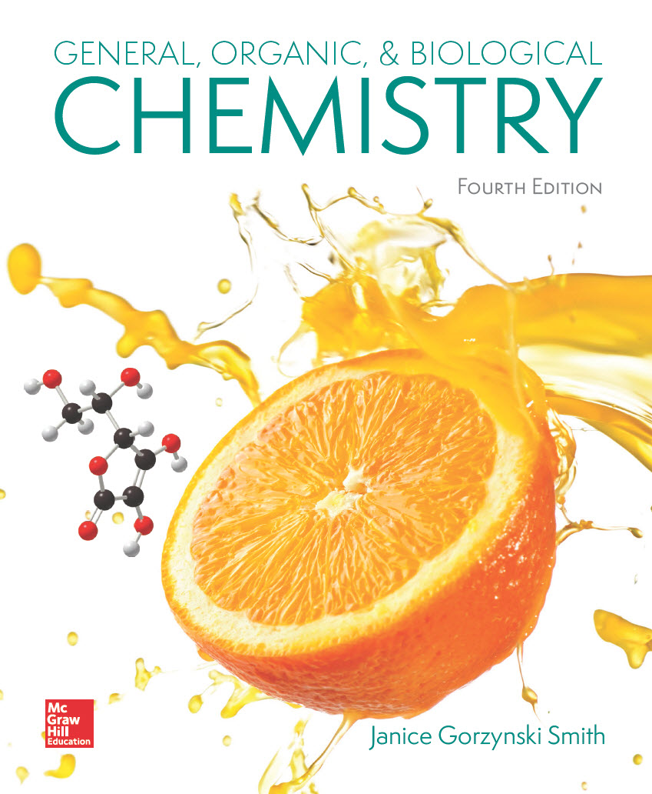
Chapter 17
Lecture
Outline
Prepared by
Harpreet Malhotra
Florida State College at Jacksonville

Slide 2
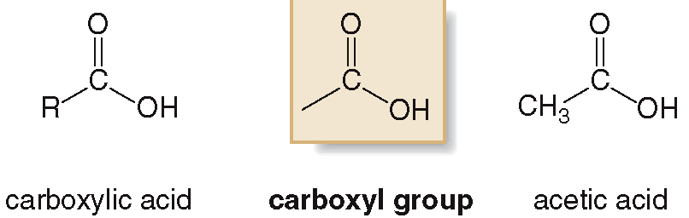
17.1 Structure and Bonding (1)
Carboxylic acids are organic compounds containing
a COOH (carboxyl) group.
General structure:
Example:
Carboxylic acids are abbreviated as RCOOH or RCO₂H.

Slide 3
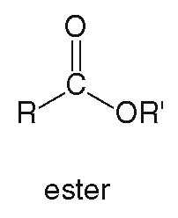
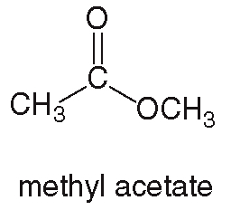
17.1 Structure and Bonding (2)
Esters are carbonyl compounds that contain an
OR’ (alkoxy) group bonded to the carbonyl C atom.
General structure:
Example:
Esters are abbreviated as RCOOR′ or RCO₂R′.

Slide 4
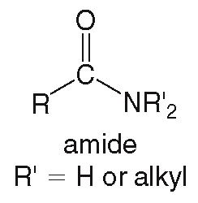
17.1 Structure and Bonding (3)
Amides are carbonyl compounds that contain a
N atom bonded to the carbonyl C.
General structure:

Slide 5
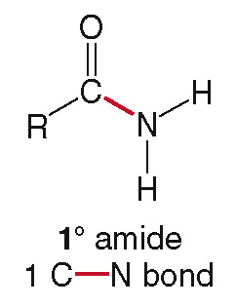
17.1 Structure and Bonding (4)
Amides are classified based on the number of C
atoms bonded to the N atom
A primary
amide contains 1
C—N bond.
It is abbreviated as RCONH₂.

Slide 6
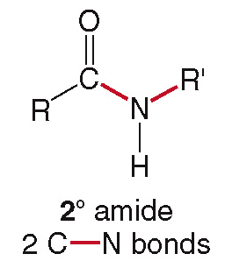
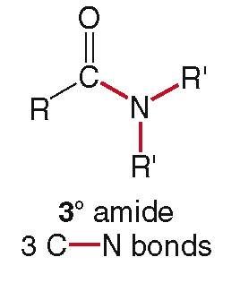
17.1 Structure and Bonding (5)
A secondary
amide
contains two C—N bonds, and is abbreviated RCONHR′.
A tertiary
amide contains
three C—N bonds, and is abbreviated RCONHR′₂.

Slide 7
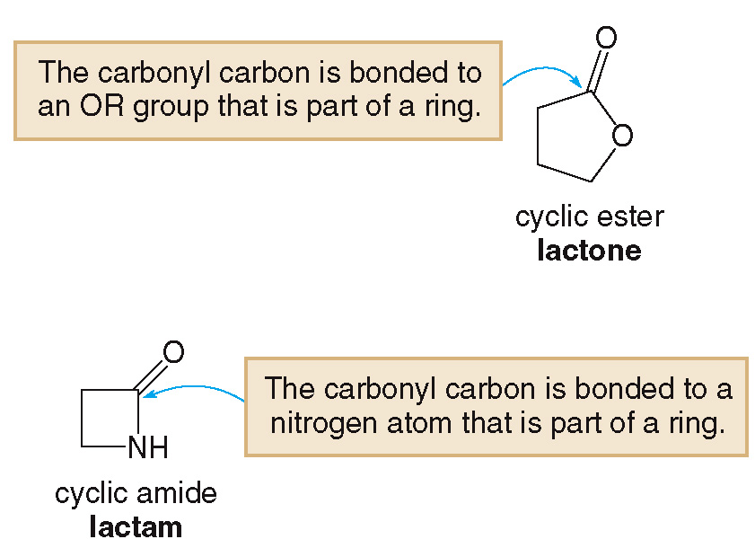
17.1 Structure and Bonding (6)
A cyclic ester is called a lactone:
A cyclic amide is called a lactam:

Slide 8
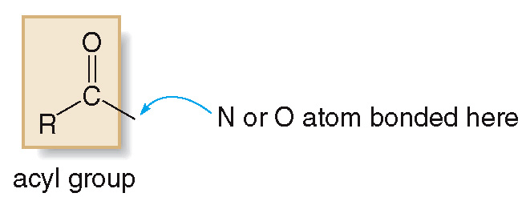
17.1 Structure and Bonding (7)
Carboxylic acids, esters, and amides all contain an acyl (RCO) group bonded to a N or O atom.

Slide 9
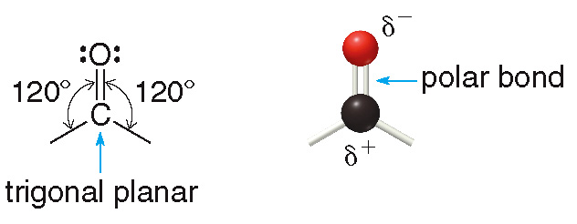
17.1 Structure and Bonding (8)
The carbonyl carbon is trigonal planar, so all bond angles are
O is more electronegative than C, so the carbonyl group is polar.
The carbonyl O is e⁻ rich
and the carbonyl
C is e⁻ poor

Slide 10
17.2 Nomenclature (1)
Naming a Carboxylic Acid (RCOOH)
To name a carboxylic acid using the IUPAC system:
Find the longest chain containing the COOH group.
Change the “-e” ending of the parent alkane
to ”-oic acid”.
Number the chain to put the COOH group at C1,
but omit “1” from the name.
Apply all other nomenclature rules.

Slide 11
17.2 Nomenclature (2)
Naming a Carboxylic Acid (RCOOH)
Sample Problem 17.1
Write the IUPAC name of the following carboxylic acid

Slide 12
17.2 Nomenclature (3)
Naming a Carboxylic Acid (RCOOH)
Sample Problem 17.1
Find and name the longest chain containing COOH.
hexane (6C’s)
---→ hexanoic acid

Slide 13
17.2 Nomenclature (4)
Naming a Carboxylic Acid (RCOOH)
Sample Problem 17.1
Number and name the substituents, making sure the COOH group is at C1.

Slide 14
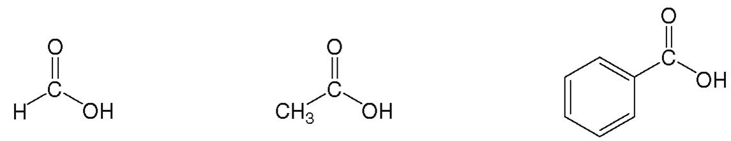
17.2 Nomenclature (5)
Naming a Carboxylic Acid (RCOOH)
Many simple carboxylic acids are referred to by their common names:
formic acid
acetic acid
benzoic acid

Slide 15
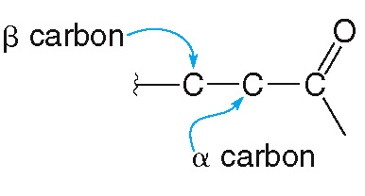
17.2 Nomenclature (6)
Naming a Carboxylic Acid (RCOOH)
The carbon adjacent to the COOH is called the
(alpha) carbon.
The carbon bonded to the
carbon is the
(beta)
carbon.

Slide 16
17.2 Nomenclature (7)
Naming an Ester (RCOOR′)
HOW TO Name an Ester Using the IUPAC System
Example
Give a IUPAC name for the ester:
Step [1]
Name the R’ group bonded to the O atom as an alkyl group.

Slide 17
17.2 Nomenclature (8)
Naming an Ester (RCOOR′)
HOW TO Name an Ester Using the IUPAC System
Step [2]
Name the acyl group (RCO-) by:
changing the “-ic acid” ending of the parent
carboxylic acid to “-ate”.
this becomes the second part of the name
Answer: ethyl acetate
acetic acid
---→ acetate

Slide 18
17.2 Nomenclature (9)
Naming an Amide
All
amides are named by replacing the “-oic acid”
ending of the parent carboxylic acid with “-amide”.

Slide 19
17.2 Nomenclature (10)
Naming an Amide
HOW TO Name an
or
Amide
Example
Give a systematic name for each amide.

Slide 20
17.2 Nomenclature (11)
Naming an Amide
HOW TO Name an
or
Amide
Step [1]
Name the alkyl groups bonded to the N atom.
Use the prefix “N-” preceding the name.

Slide 21
17.2 Nomenclature (12)
Naming an Amide
HOW TO Name an
or
Amide
Step [2]
Name the acyl group with the suffix “-amide”.
Answer:
Answer:
N-ethylformamide
N,N-Dimethylbenzamide

Slide 22
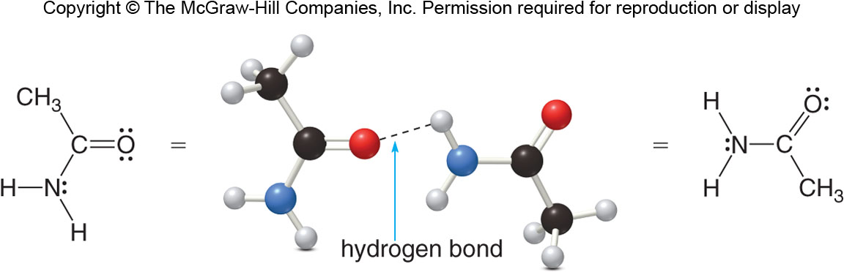
17.3 Physical Properties (1)
Carboxylic acids, esters, and amides are all polar compounds.
Only carboxylic acids and
and
amides can
undergo intermolecular hydrogen bonding.

Slide 23
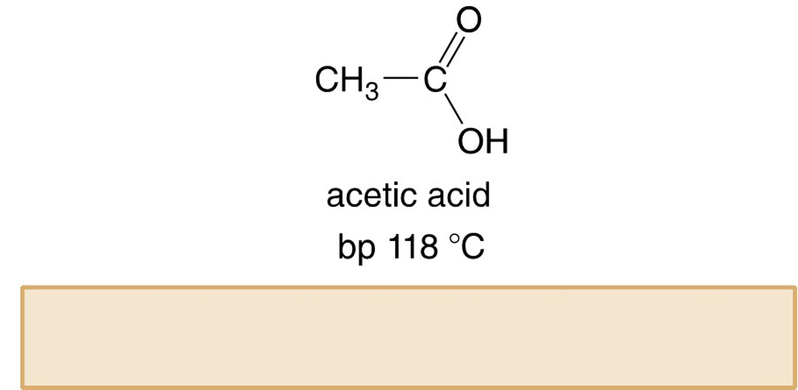
17.3 Physical Properties (2)
Carboxylic acids have higher boiling points than
similar alcohols because there are more hydrogen
bonding interactions possible than alcohols.
CH₃CH₂CH₂OH
1-propanol
more hydrogen-bonding interactions possible higher boiling point

Slide 24
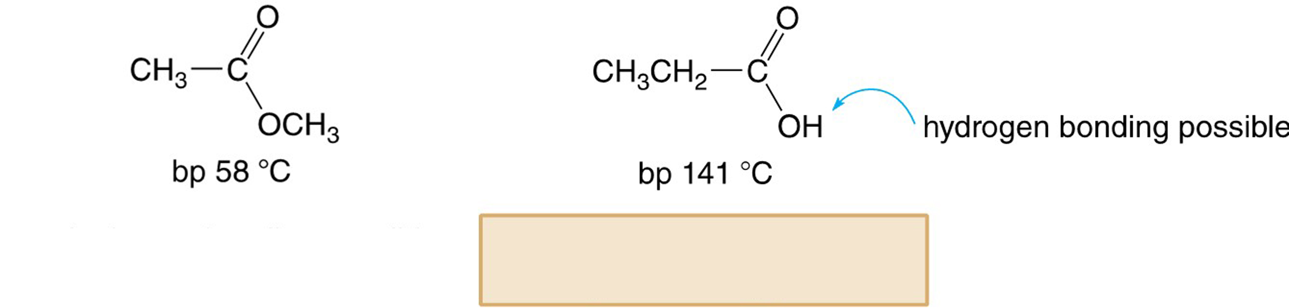
17.3 Physical Properties (3)
Carboxylic acids also have higher boiling points than esters because esters are incapable of intermolecular hydrogen bonding.
stronger intermolecular forces higher boiling point

Slide 25
17.3 Physical Properties (4)
and
amides have higher boiling points than
amides and esters because of intermolecular
hydrogen bonding.

Slide 26
17.4 Interesting Carboxylic Acids (1)
Simple carboxylic acids have foul or biting odors.
Formic acid (HCO₂H) is responsible for the sting of some types of ants.
Acetic acid (CH₃CO₂H) is the sour-tasting component of vinegar; it can be made by air oxidation of ethanol when wine “goes bad”.
Hexanoic acid [(CH₃(CH₂)₄COOH)] has the foul odor of dirty socks and locker rooms.

Slide 27
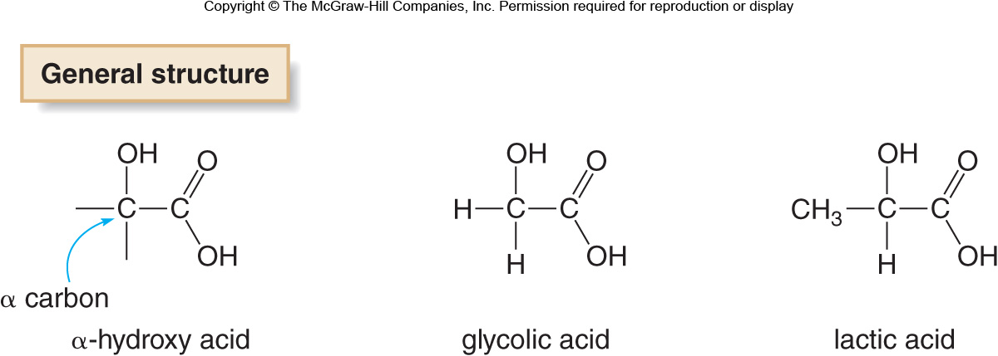
17.4 Interesting Carboxylic Acids (2)
Skin Care Products
Several skin care products purported to smooth fine lines contain
These acids work by removing the outer, older layer of skin cells, revealing the healthier looking, new cells underneath.

Slide 28
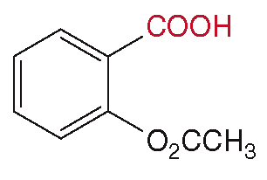
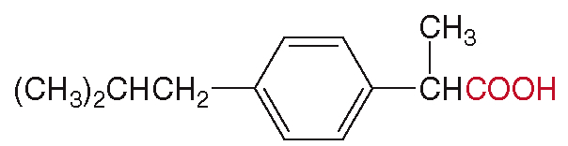
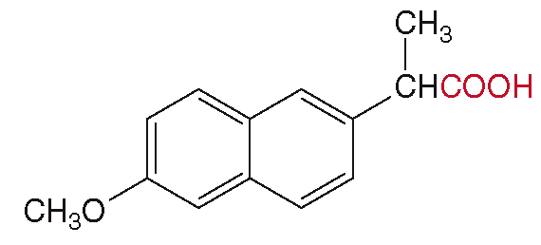
17.4 Interesting Carboxylic Acids (3)
Focus on Health & Medicine
Three common pain relievers that are also anti-inflammatory agents contain a carboxyl group:
aspirin
ibuprofen
naproxen

Slide 29
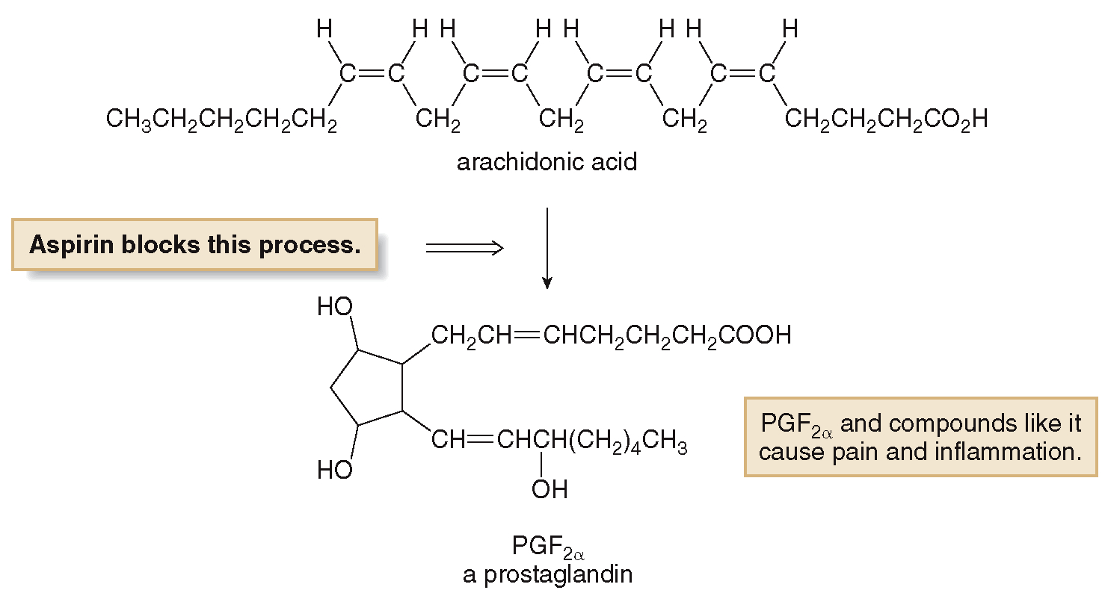
17.4 Interesting Carboxylic Acids (4)
Focus on Health & Medicine
Pain relievers work because they block the synthesis of prostaglandins, compounds responsible for pain responses in the body.

Slide 30
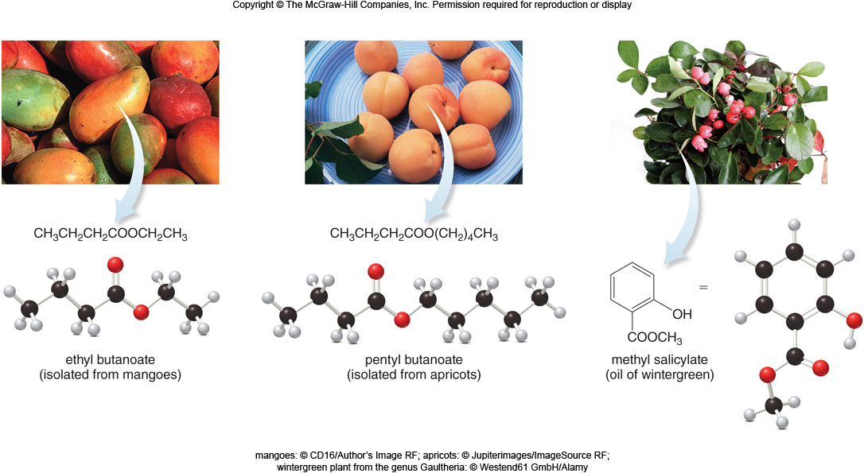
17.5 Interesting Esters and Amides (1)
Many low molecular weight esters have pleasant odors:
mangoes: © CD16/Author’s Image RF; apricots: © Jupiterimages/ImageSource RF; wintergreen plant from the genus Gaultheria: © Westend61 GmbH/Alamy

Slide 31
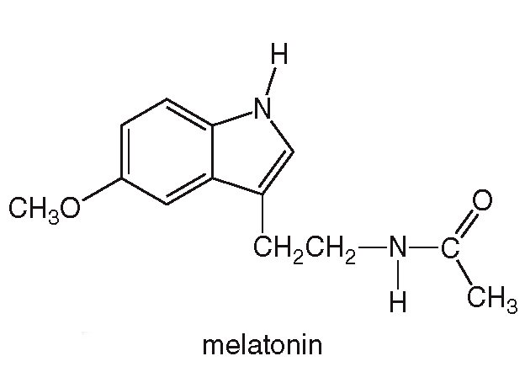
17.5 Interesting Esters and Amides (2)
The amide melatonin is thought to induce sleep because it’s production is increased by the body during the evening.

Slide 32
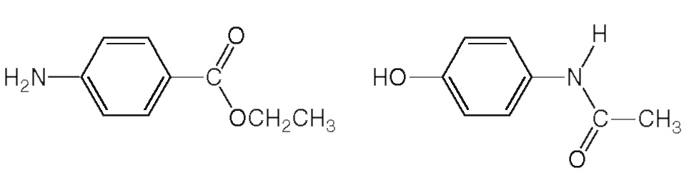
17.5 Interesting Esters and Amides (3)
The ester benzocaine is the active ingredient in topical anesthetics.
The amide acetaminophen is a pain reliever in Tylenol.
benzocaine
acetaminophen

Slide 33
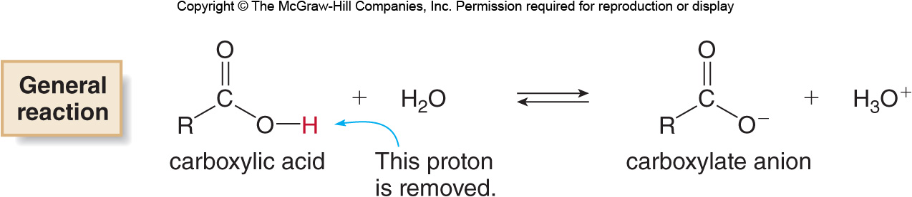
17.6 The Acidity of Carboxylic Acids (1)
Carboxylic acids are proton
donors:
They are weak acids compared to inorganic acids like HCl or H₂SO₄.
Only a small percentage of a carboxylic acid is ionized in aqueous solution.

Slide 34
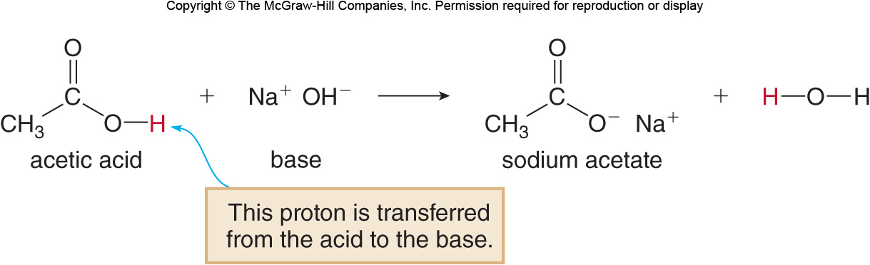
17.6 The Acidity of Carboxylic Acids (2)
Reaction with Bases
Carboxylic acids react with bases such as NaOH to form water-soluble salts.
The carboxylic acid donates the proton to the base,
, which accepts it.

Slide 35
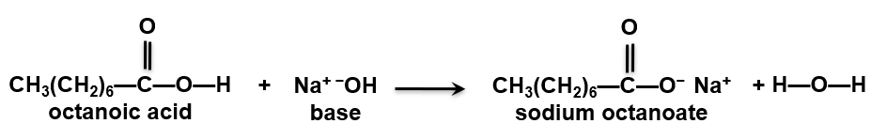
17.6 The Acidity of Carboxylic Acids (3)
Carboxylate Anions—Salts of Carboxylic Acids
The salts of carboxylic acids formed by acid-base reactions are water-soluble ionic solids.
Thus, the reaction will turn a water insoluble carboxylic acid into a water soluble carboxylic acid salt.
water insoluble
water soluble

Slide 36
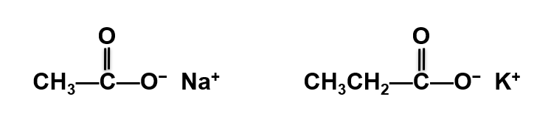
17.6 The Acidity of Carboxylic Acids (4)
Carboxylate Anions—Salts of Carboxylic Acids
To name the metal salts of carboxylate ions, put the three pieces below together:
name of the metal cation + parent + −ate(suffix)
sodium acetate
potassium propanoate

Slide 37
17.6 The Acidity of Carboxylic Acids (5)
How Does Soap Clean Away Dirt?
Soap has been used by humankind for approximately 2000 years.
Soaps are salts of carboxylic acids that have many C atoms in long hydrocarbon chain.
A soap molecule has two parts:
The polar head is the ionic end.
The nonpolar tail is the carbon chain of
nonpolar C—C and C—H bonds.

Slide 38
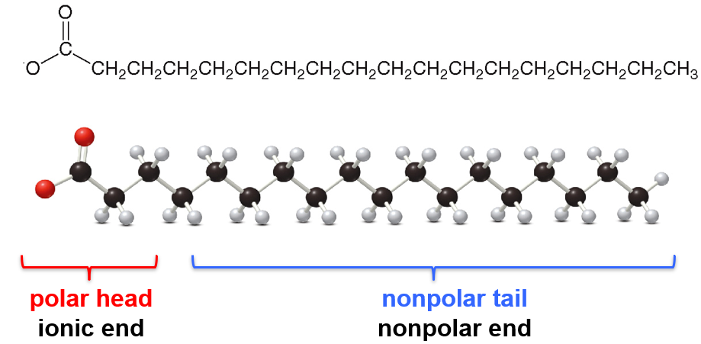
17.6 The Acidity of Carboxylic Acids (6)
How Does Soap Clean Away Dirt?
Structure of a soap molecule:

Slide 39
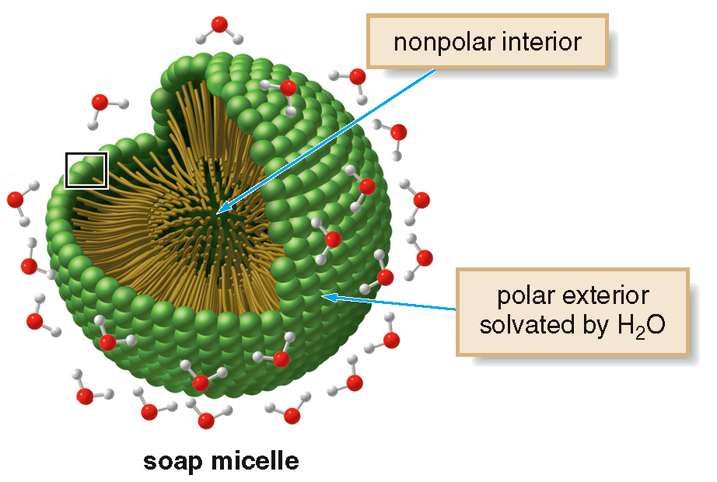
17.6 The Acidity of Carboxylic Acids (7)
How Does Soap Clean Away Dirt?
In water, soap forms micelles, spherical droplets
with the ionic heads on the surface and the nonpolar
tails packed together in the interior.

Slide 40
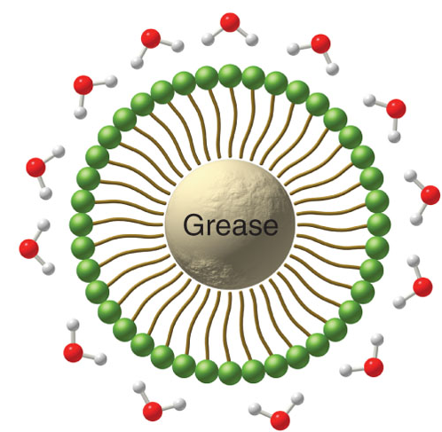
17.6 The Acidity of Carboxylic Acids (8)
How Does Soap Clean Away Dirt?
Nonpolar hydrocarbon tails trap nonpolar material like grease and oil.
The polar head remains on the surface, sealing off the grease and oil, and washes away in the presence of water.

Slide 41
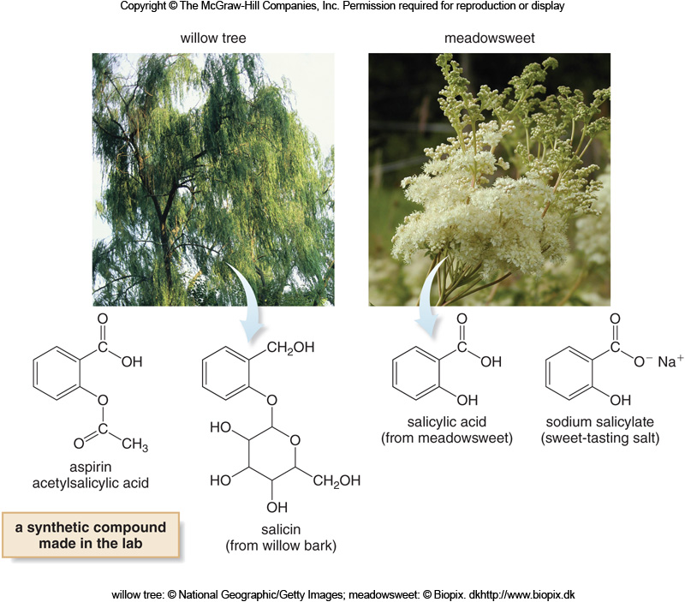
17.7 Focus on Health & Medicine (1)
willow tree: © National Geographic/Getty Images; meadowsweet: © Biopix. dkhttp://www.biopix.dk

Slide 42
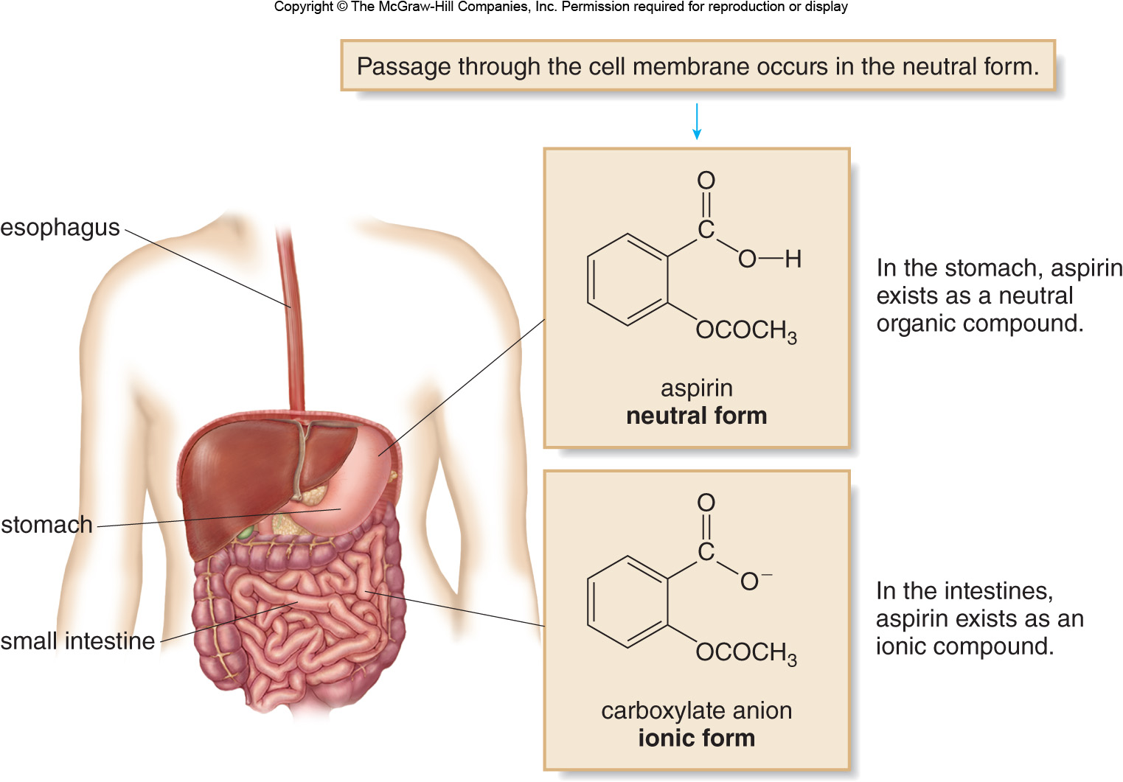
17.7 Focus on Health & Medicine (2)

Slide 43
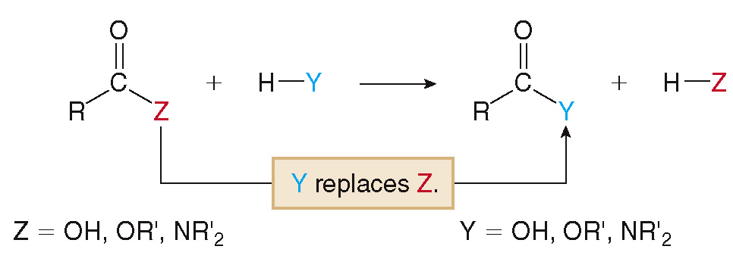
17.8 The Conversion of Carboxylic Acids to Esters and Amides (1)
All acyl compounds undergo a common reaction type—substitution.

Slide 44
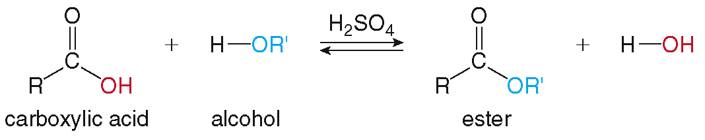
17.8 The Conversion of Carboxylic Acids to Esters and Amides (2)
Carboxylic acids react with alcohols to form esters.
The OR′ group replaces the OH group.

Slide 45
17.8 The Conversion of Carboxylic Acids (1)
Ester Formation
Formation of an ester is done by the Fisher esterification:

Slide 46
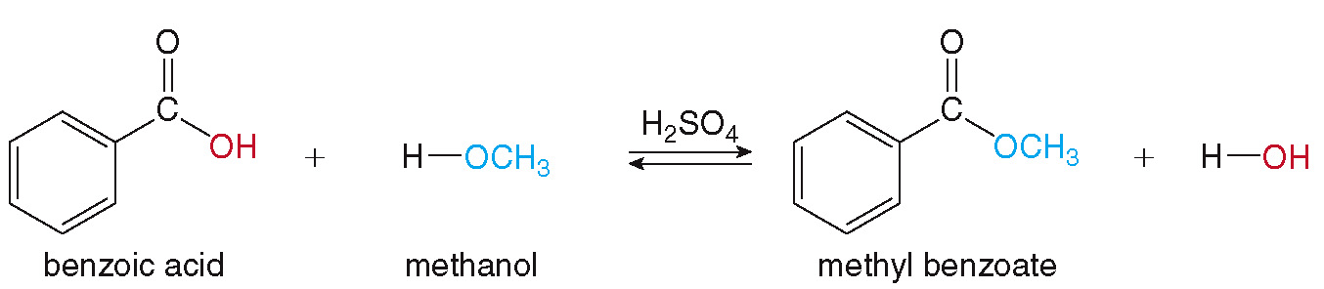
17.8 The Conversion of Carboxylic Acids (2)
Ester Formation
The Fisher esterification is an equilibrium process.
According to Le Châtelier’s principle, the reaction is driven to the right by:
using excess alcohol
removing the water as it is formed

Slide 47
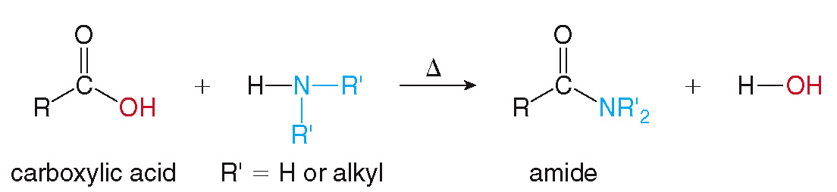
17.8 The Conversion of Carboxylic Acids (3)
Amide Formation
Heating a carboxylic acid with ammonia (NH₃) or an amine (R′NH₂ or R′₂NH) forms an amide.

Slide 48
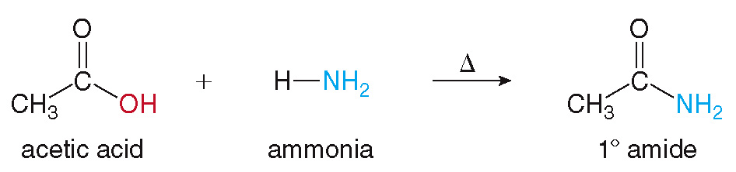
17.8 The Conversion of Carboxylic Acids (4)
Amide Formation
The identity of the N-compound determines the
type of amide formed.
Reaction with NH₃ forms a
(RCONH₂).

Slide 49
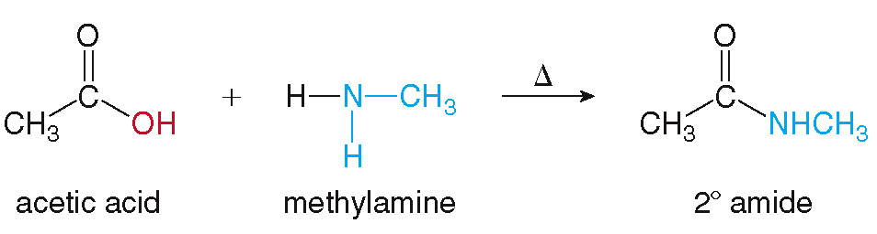
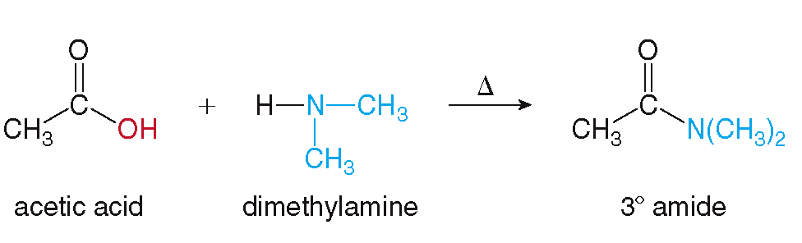
17.8 The Conversion of Carboxylic Acids (5)
Amide Formation
Reaction with R′NH₂ forms a
(RCONHR′).
Reaction with R′₂NH forms a
(RCONR′₂).

Slide 50
17.9 Hydrolysis of Esters and Amides (1)
Ester Hydrolysis
An ester reacts with water to form a carboxylic acid and an alcohol; this is a hydrolysis reaction.
The OH group replaces the OR′ group.

Slide 51
17.9 Hydrolysis of Esters and Amides (2)
Ester Hydrolysis
An example of ester hydrolysis using an acid catalyst:
The equilibrium is driven to the right by using a large amount of water.

Slide 52
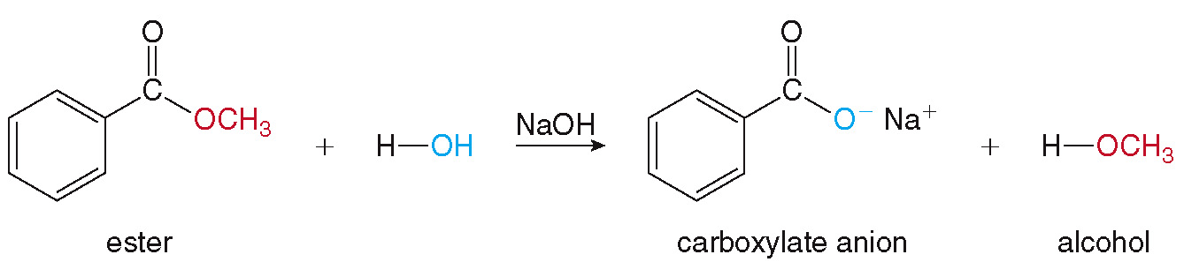
17.9 Hydrolysis of Esters and Amides (3)
Ester Hydrolysis
An example of ester hydrolysis using an aqueous base, called saponification:
This basic hydrolysis forms the carboxylate anion rather than the carboxylic acid product.

Slide 53
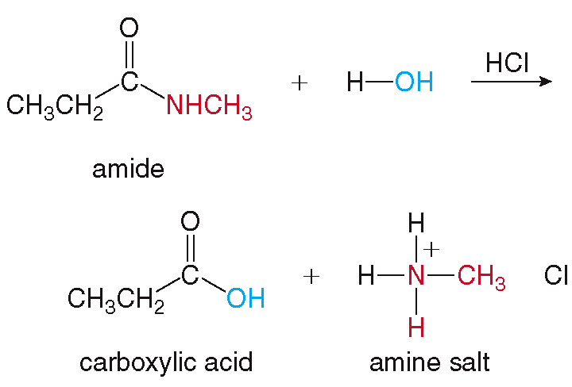
17.9 Hydrolysis of Esters and Amides (4)
Amide Hydrolysis
Treatment of an amide with water in the presence of an acid catalyst (HCl) forms a carboxylic acid and an amine salt.

Slide 54
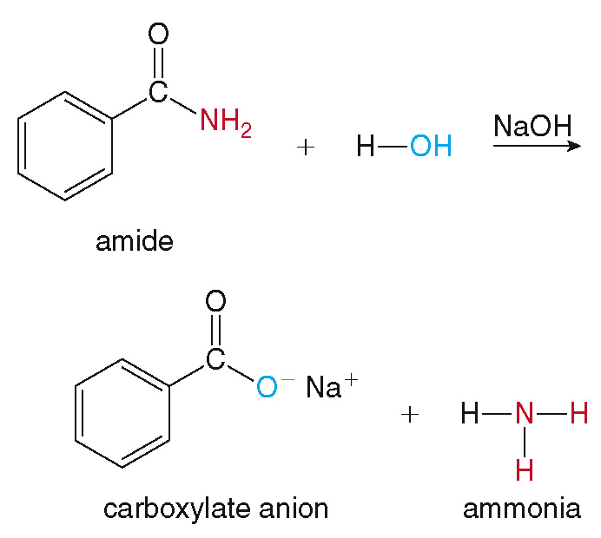
17.9 Hydrolysis of Esters and Amides (5)
Amide Hydrolysis
Amides are also hydrolyzed in aqueous base to form carboxylate anions and amines.

Slide 55
17.9 Hydrolysis of Esters and Amides (6)
Focus on Health & Medicine
Triacylglycerols, common naturally occurring esters, contain three ester groups, each with a long C chain.
They are lipids, water insoluble organic compounds, present in fats and oils.

Slide 56
17.9 Hydrolysis of Esters and Amides (7)
Focus on Health & Medicine
Animals store energy in the form of triacylglycerols.
Using enzymes called lipases, the three ester
bonds are hydrolyzed when the triacylglycerol is metabolized.
Diets high in fat lead to obesity, so the “fake fat” olestra (Olean) was invented to replace some triacylglycerols in snack foods.
The lipase enzymes cannot hydrolyze the olestra,
so it passes through the body unmetabolized, providing no calories to the consumer.

Slide 57
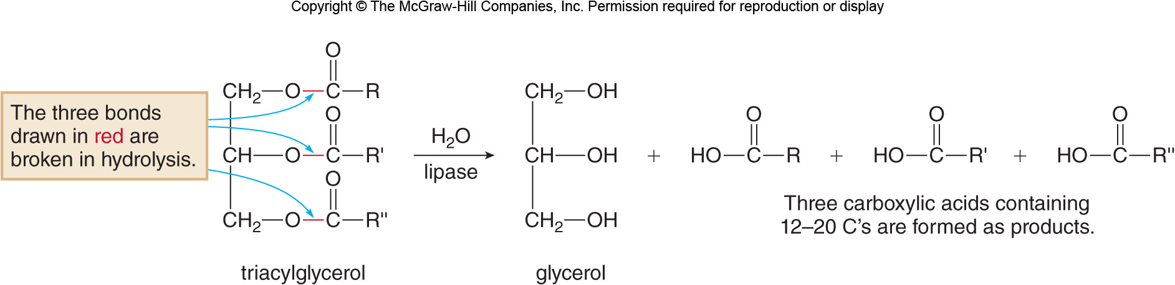
17.9 Hydrolysis of Esters and Amides (8)
Focus on Health & Medicine

Slide 58
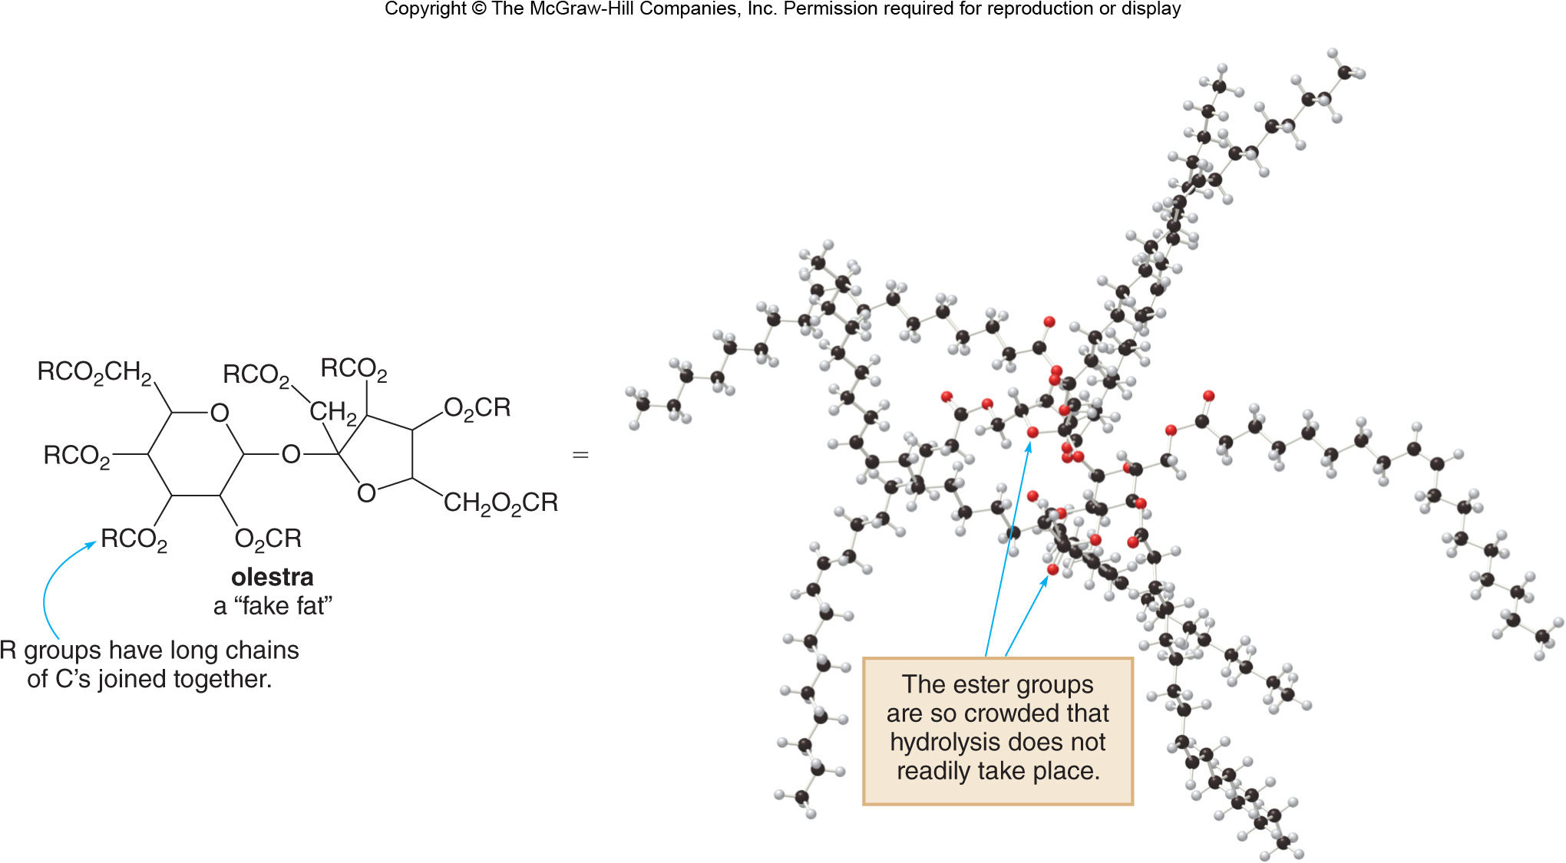
17.9 Hydrolysis of Esters and Amides (9)
Focus on Health & Medicine

Slide 59
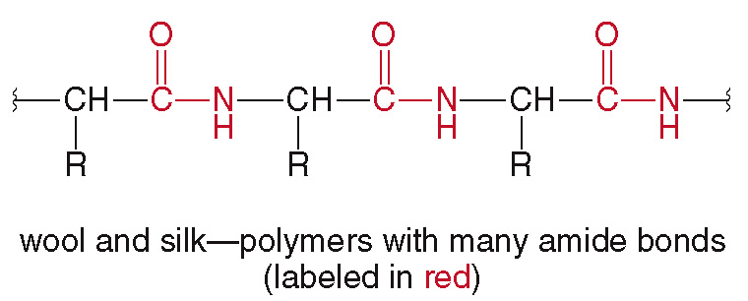
17.10 Synthetic Polymers (1)
Fibers like wool and silk obtained from animals are proteins joined together by many amide linkages.
Two common classes of synthetic polymers are polyamides and polyesters.

Slide 60
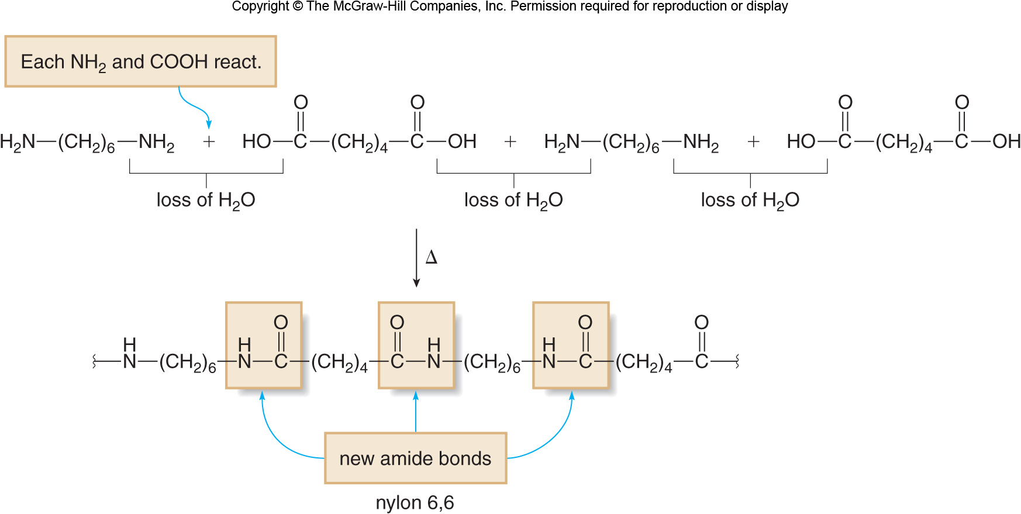
17.10 Synthetic Polymers (2)
Nylon—A Polyamide
Nylon is a condensation polymer, formed when two monomers come together, releasing water.

Slide 61
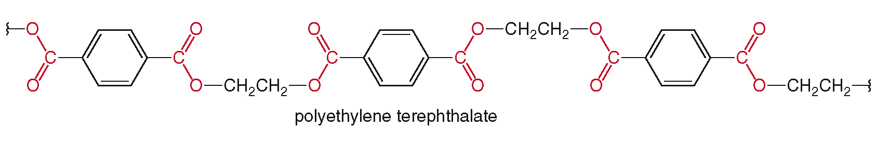
17.10 Synthetic Polymers (3)
Polyesters
The most common polyester is polyethylene terephthalate (PET) used for materials Dacron and Mylar and in making plastic soft drink bottles.
PET is easily and cheaply made and forms strong stable materials.
PET with ester bonds drawn in red.

Slide 62
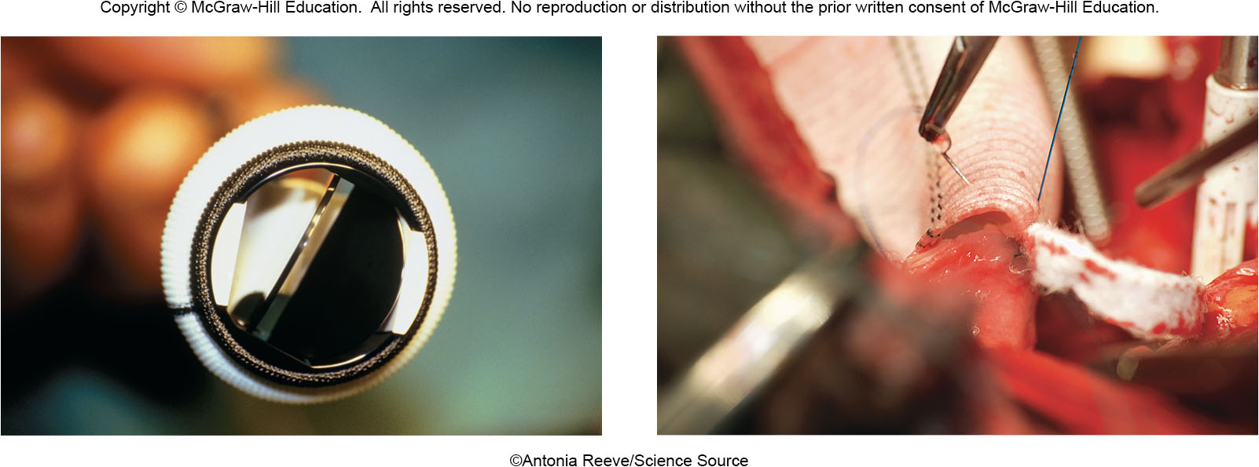
17.10 Synthetic Polymers (4)
Polyesters
©Antonia Reeve/Science Source

Slide 63
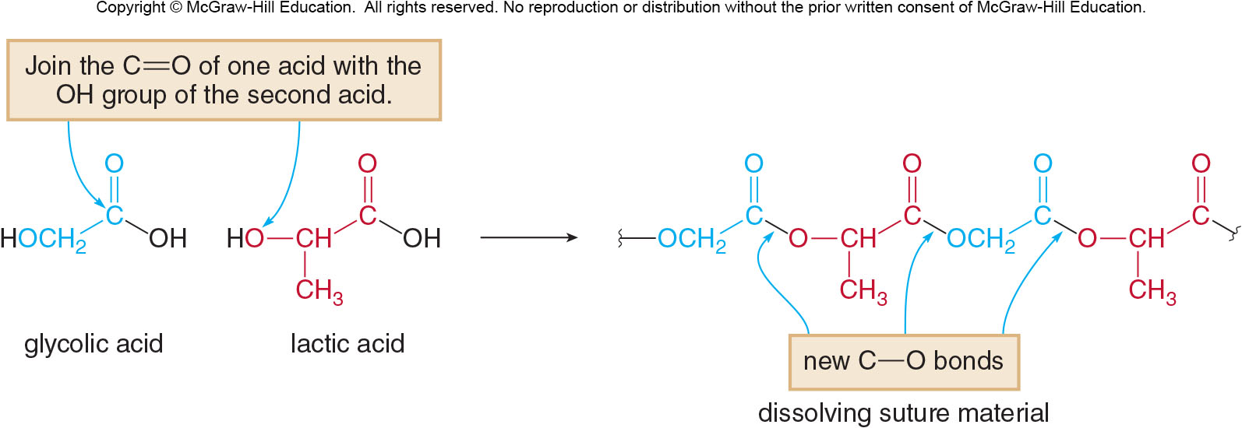
17.10 Synthetic Polymers (5)
Focus on Health & Medicine
Slowly degrading polyesters are useful in making sutures.
The mending tissue is held together for a length of time to heal, and then the sutures break down.

Slide 64
17.10 Synthetic Polymers (6)
Focus on the Environment
Many polymers do not degrade readily, and billions of pounds of polymers end up in landfills.
The lower a polymer’s recycling code (1 to 6), the easier it is to recycle the polymer to combat the waste problem.
PET has a recycling code “1”, as it is the easiest to recycle, and is re-used as fleece clothing and carpeting.
Heating PET with H₂O and acid returns the polymer to its monomer units, which serve as starting material for more PET.

Slide 65

17.11 Focus on Health & Medicine Penicillin
The antibiotic properties of penicillin were first discovered in 1928 by Sir Alexander Fleming.
Penicillin interferes with the enzyme that synthesizes bacterial cell walls, killing the bacterium.
All penicillins contain a

Slide 66

17.11 Focus on Health & Medicine Common Penicillins Used Today

