Slide 1

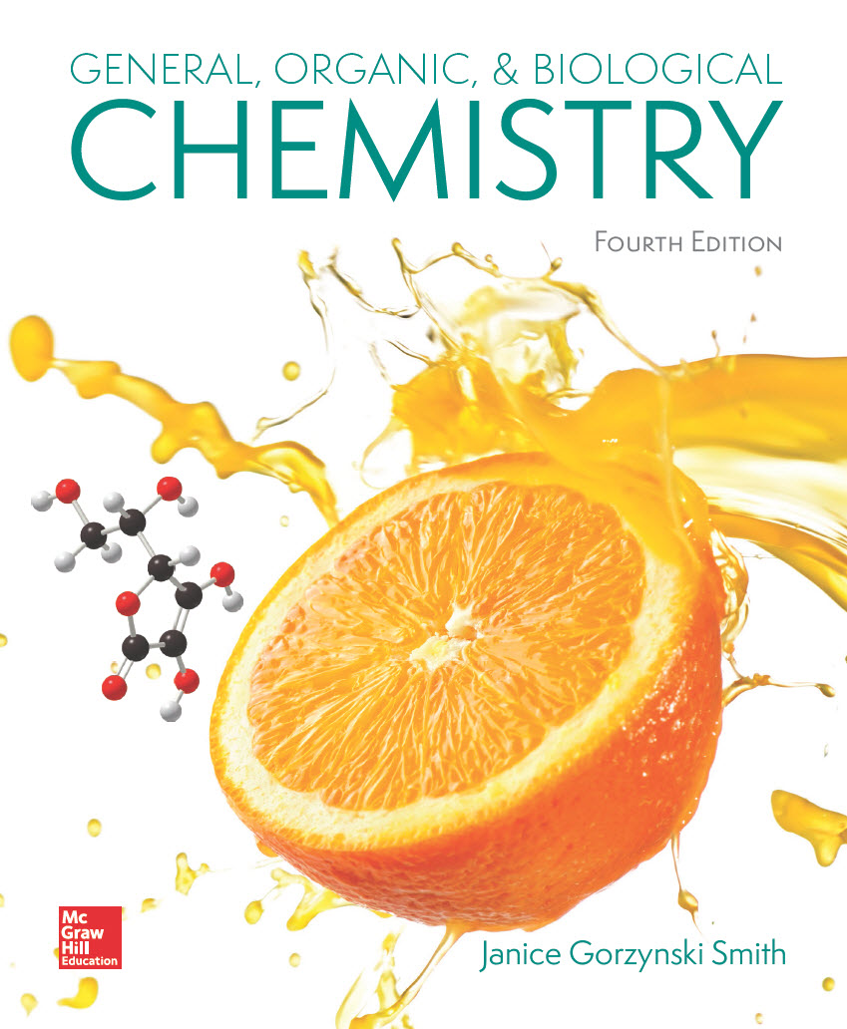
Chapter 16
Lecture Outline
Prepared by
Harpreet Malhotra
Florida State College at Jacksonville

Slide 2
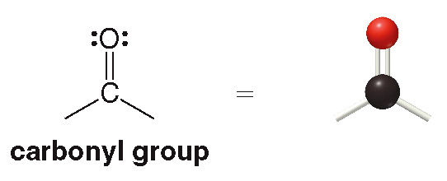
16.1 Structure and Bonding (1)
Two broad classes of compounds contain a carbonyl
group:

Slide 3
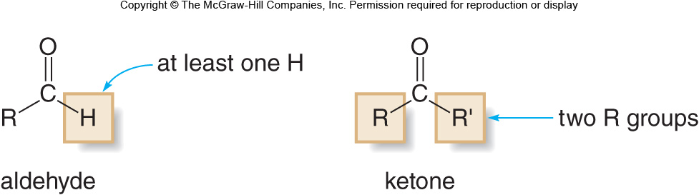
16.1 Structure and Bonding (2)
Compounds that have only C and H atoms bonded to the carbonyl group:
An aldehyde has at least one H atom bonded to the carbonyl group.
A ketone has two alkyl groups bonded to the carbonyl group.

Slide 4
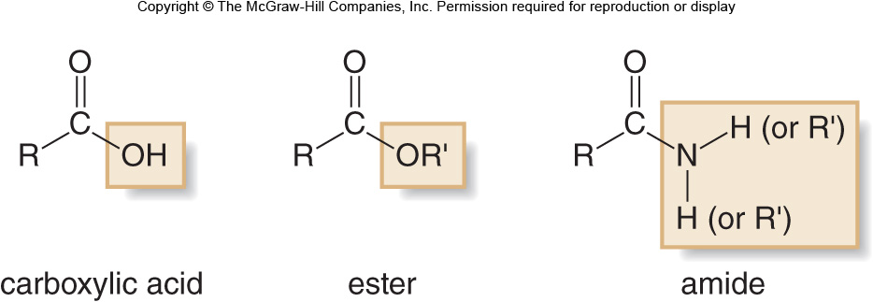
16.1 Structure and Bonding (3)
Compounds that contain an electronegative atom
(N or O) bonded to the carbonyl group:

Slide 5
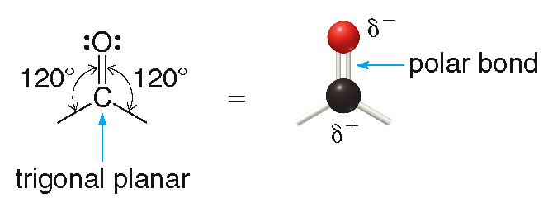
16.1 Structure and Bonding (4)
The carbonyl carbon atom is trigonal planar, with bond angles of
O is more electronegative than C, so the carbonyl group is polar.
The carbonyl O is e⁻ rich
and the carbonyl C is
e⁻ poor

Slide 6
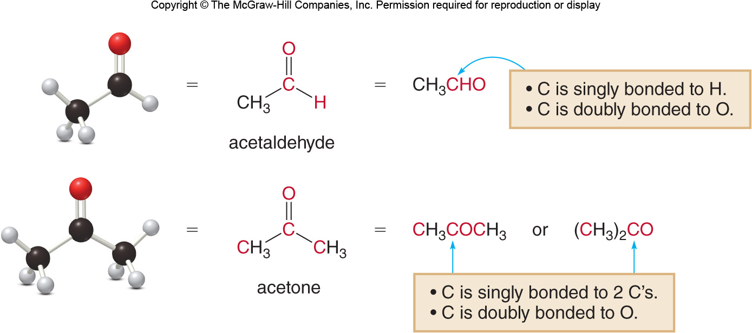
16.1 Structure and Bonding (5)

Slide 7
16.2 Nomenclature (1)
Naming Aldehydes
To name an aldehyde using the IUPAC system:
Find the longest chain containing the CHO group.
Change the “-e” ending of the parent alkane to ”-al”.
Number the chain to put the CHO group at C1, but omit “1” from the name.
Apply all other nomenclature rules.

Slide 8
16.2 Nomenclature (2)
Naming Aldehydes
Sample Problem 16.1
Give the IUPAC name for each aldehyde

Slide 9
16.2 Nomenclature (3)
Naming Aldehydes
Sample Problem 16.1
Find and name the longest chain containing the CHO.
butane (4 C’s)
---→ butanal
pentane (5 C’s)
---→ pentanal

Slide 10
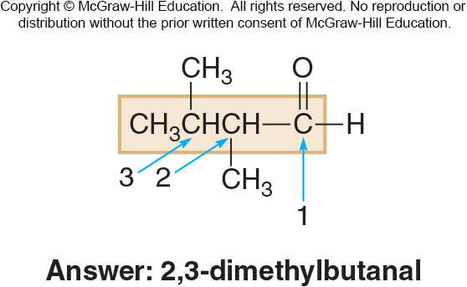
16.2 Nomenclature (4)
Naming Aldehydes
Sample Problem 16.1
Number and name substituents, making sure the CHO group is at C1.

Slide 11
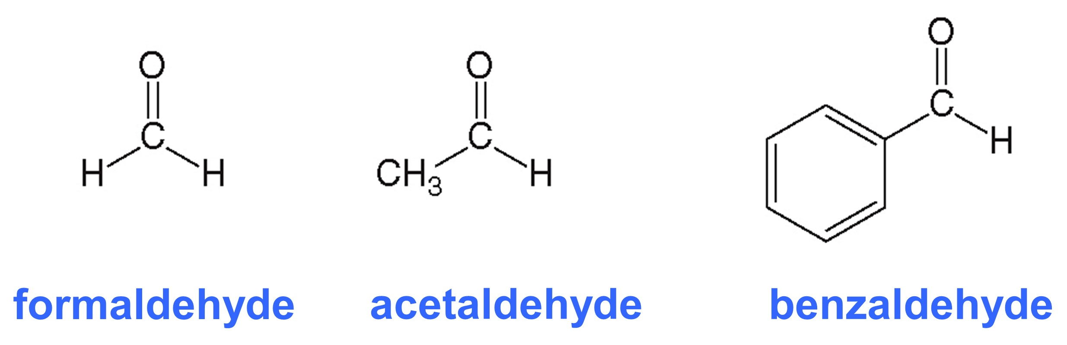
16.2 Nomenclature (5)
Naming Aldehydes
Common names are used for simple aldehydes;
the names contain the suffix “-aldehyde”.

Slide 12
16.2 Nomenclature (6)
Naming Ketones
To name an ketone using the IUPAC system:
Find the longest chain containing the carbonyl group.
Change the “-e” ending of the parent alkane to ”-one”.
Number the chain to give the carbonyl carbon the lower number.
Apply all other nomenclature rules

Slide 13
16.2 Nomenclature (7)
Naming Ketones
Sample Problem 16.1
Give the IUPAC name for each ketone.

Slide 14
16.2 Nomenclature (8)
Naming Ketones
Sample Problem 16.1
Find and name the longest chain containing the carbonyl group.
pentane (5 C’s)
---→ pentanone
cyclohexane (6 C’s)
---→ cyclohexanone

Slide 15
16.2 Nomenclature (9)
Naming Ketones
Sample Problem 16.1
Number and name substituents, making sure the carbonyl carbon has the lowest possible number.

Slide 16
16.2 Nomenclature (10)
Naming Ketones
Common names for ketones are formed by naming
both alkyl groups, arranging them alphabetically,
and adding the word “-ketone”

Slide 17
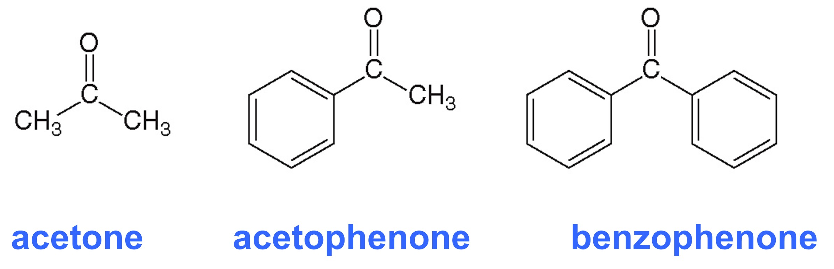
16.2 Nomenclature (11)
Naming Ketones
Some widely used common names do not follow
the convention:

Slide 18
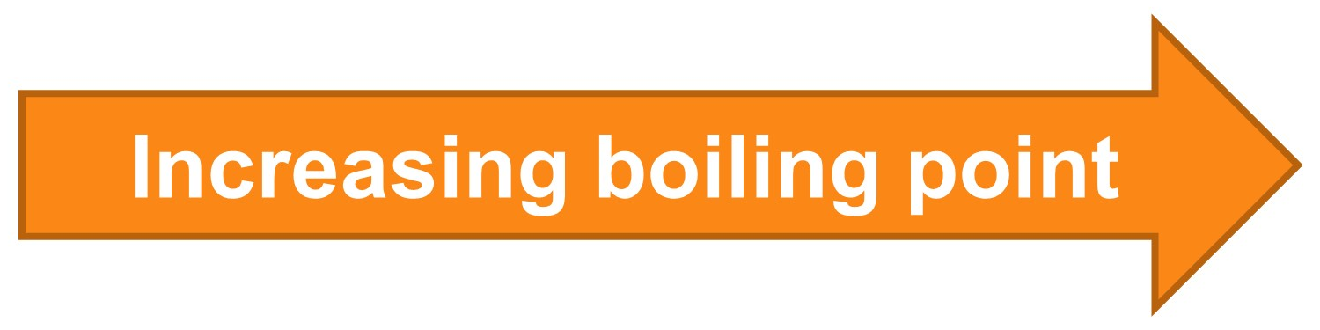
16.3 Physical Properties (1)
Aldehydes and ketones have higher boiling points than similar hydrocarbons because:
they are polar molecules
they have stronger intermolecular forces than alkanes and alkenes
CH₃CH₂CH₂CH₂CH₃
pentane
CH₃CH₂CH₂CHO
butanal

Slide 19
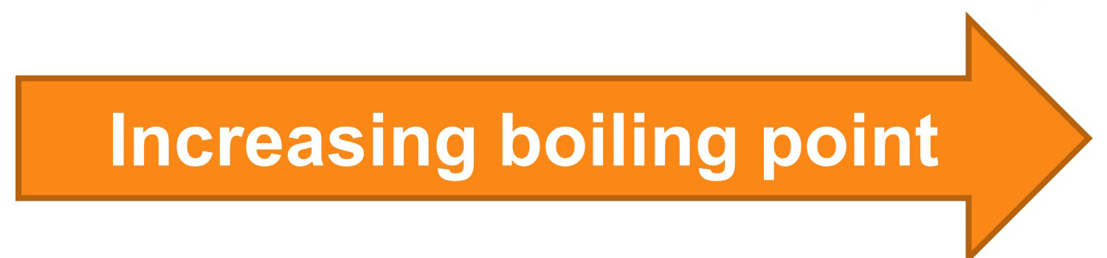
16.3 Physical Properties (2)
Aldehydes and ketones have lower boiling points
than similar alcohols because:
they do not have an O—H bond
they cannot have intermolecular hydrogen bonding
they have weaker intermolecular forces than alcohols
CH₃CH₂COCH₃
2-butanone
CH₃CH₂CH₂CH₂OH
1-butanol

Slide 20
16.3 Physical Properties (3)
Aldehydes and ketones are soluble in organic solvents.
Those molecules with 6 C’s or less are soluble in water.
Those molecules with 7 C’s or more are insoluble in water.

Slide 21
16.4 Focus on Health & Medicine (1)
Interesting Aldehydes and Ketones
Formaldehyde (CH₂ = O) is the simplest aldehyde:
It is the starting material for synthesis of resins and plastics.
It is sold as formalin, a 37% aqueous solution used to preserve biological specimens.

Slide 22
16.4 Focus on Health & Medicine (2)
Interesting Aldehydes and Ketones
Acetone [(CH₃)₂C = O] is the simplest ketone:
It is an industrial solvent and a starting material for organic polymers.
It is produced in the breakdown of fatty acids in the body.
Unusually high levels are found in diabetic patients.

Slide 23
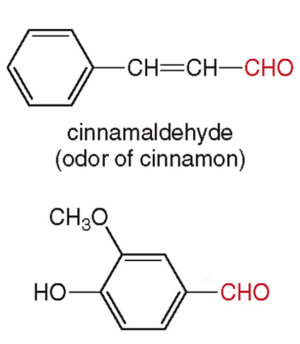
16.4 Focus on Health & Medicine (3)
Interesting Aldehydes and Ketones
Cinnamaldehyde, the major component of
cinnamon bark:
Vanillin, the primary component of the extract of the
vanilla bean:

Slide 24
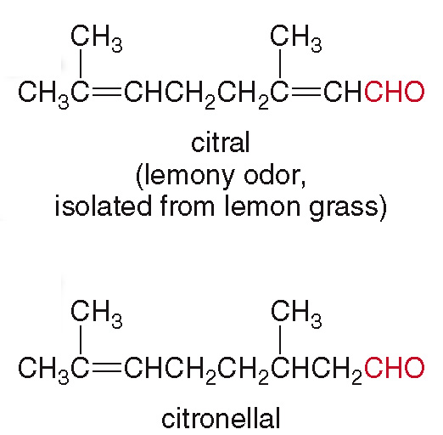
Focus on Health & Medicine
Interesting Aldehydes and Ketones
Gerenial, the characteristic odor of lemon grass, used
in perfumery and in synthesis of vitamin A:
Citronellal, the odor of citronella candles, used to
repel mosquitoes:

Slide 25
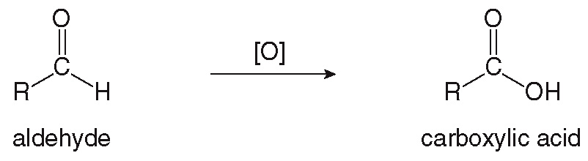
16.5 Reactions of Aldehydes and Ketones (1)
General Considerations
Aldehydes and ketones undergo two general types
of reactions:
Aldehydes can be oxidized to carboxylic acids:

Slide 26
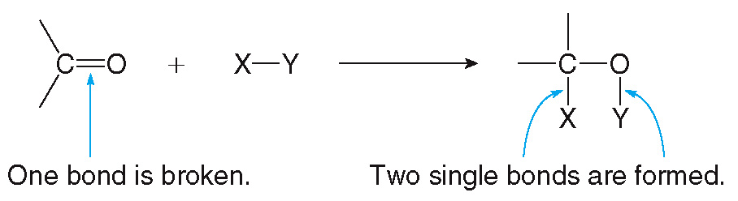
16.5 Reactions of Aldehydes and Ketones (2)
General Considerations
Aldehydes and ketones undergo two general types
of reactions:
Aldehydes and ketones undergo addition reactions:

Slide 27
16.5 Reactions of Aldehydes and Ketones (3)
Oxidation of Aldehydes
In oxidation, the aldehyde C—H bond is converted
into a carboxylic acid C—OH bond.

Slide 28
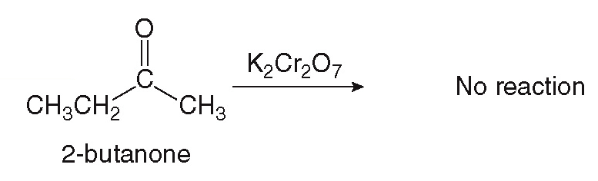
16.5 Reactions of Aldehydes and Ketones (4)
Oxidation of Aldehydes
Ketones cannot be oxidized because there is no
C—H bond.

Slide 29
16.5 Reactions of Aldehydes and Ketones (5)
Oxidation of Aldehydes
Aldehydes can be selectively oxidized in the presence
of other functional groups using the Tollens reagent.

Slide 30
16.6 Reduction of Aldehydes and Ketones (1)
Reduction is the opposite of oxidation; it results in:
a decrease in the number of C—O bonds
or, an increase in the number of C—H bonds

Slide 31
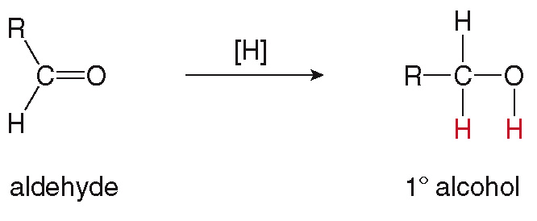
16.6 Reduction of Aldehydes and Ketones (2)
Specific Features of Carbonyl Reductions
Aldehydes are reduced to
[H] is used to represent a general reduction reagent.
H₂ gas in the presence of Pd metal is a commonly used reagent.

Slide 32
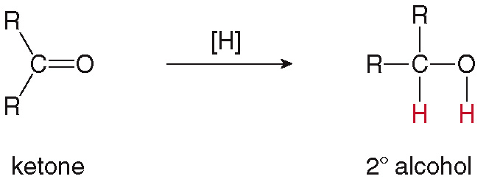
16.6 Reduction of Aldehydes and Ketones (3)
Specific Features of Carbonyl Reductions
Ketones are reduced to

Slide 33
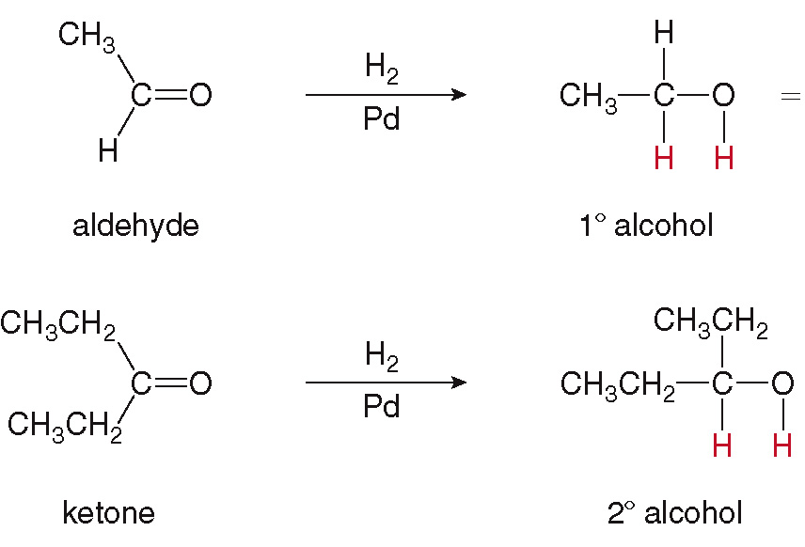
16.6 Reduction of Aldehydes and Ketones (4)
Specific Features of Carbonyl Reductions

Slide 34
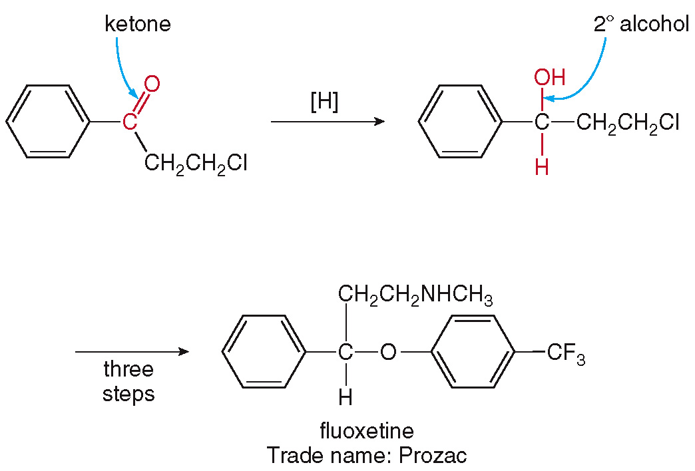
16.6 Reduction of Aldehydes and Ketones (5)
B. Example of Carbonyl Reduction in Organic Synthesis
For example, the reduction reaction is used in the synthesis of the drug Prozac:

Slide 35
16.6 Reduction of Aldehydes and Ketones (6)
Focus on the Human Body
Biological systems do not have H₂ and Pd to use as a reducing agent.
Instead they use the coenzyme NADH in the presence of an enzyme.
In acting as a reducing agent the NADH is oxidized to
, which is a biological oxidizing agent.

Slide 36
16.7 Focus on the Human Body (1)
The Chemistry of Vision
The human eye consists of two types of light-sensitive cells—the rod and the cone cells.
The chemistry of vision in the rod cells centers around the aldehyde 11-cis-retinal.
The cis double bond is isomerized into the more stable trans double bond when light hits the retina.
This process sends a nerve impulse to the brain, which is then converted into a visual image.

Slide 37
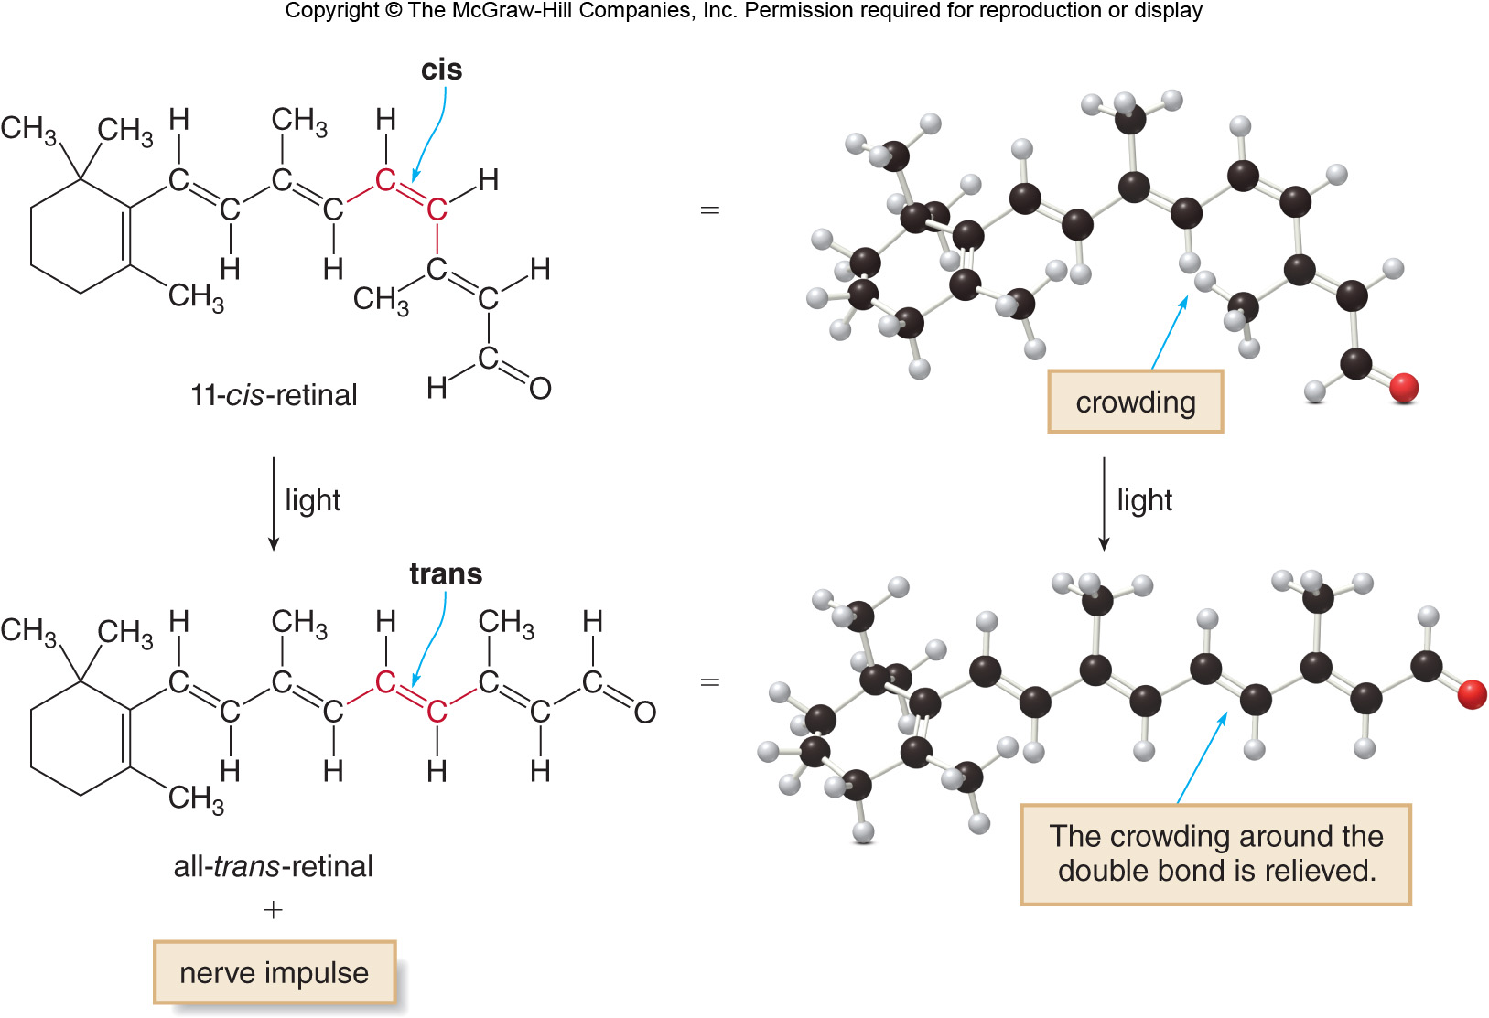
16.7 Focus on the Human Body (2)
The Chemistry of Vision

Slide 38
16.7 Focus on the Human Body (3)
The Chemistry of Vision
In order for the process to continue, the all-trans-retinal must be converted back to 11-cis-retinal.
This is done by a series of biological oxidation and reduction reactions.
The all-trans-retinal aldehyde is first reduced by NADH to an all-trans-retinol alcohol, Vitamin A.
The all-trans-retinol is then isomerized to 11-cis-retinol and finally oxidized by
back to the
aldehyde 11-cis-retinal.
As this reaction helps us see in dim light, a lack of Vitamin A in the diet causes night blindness.

Slide 39
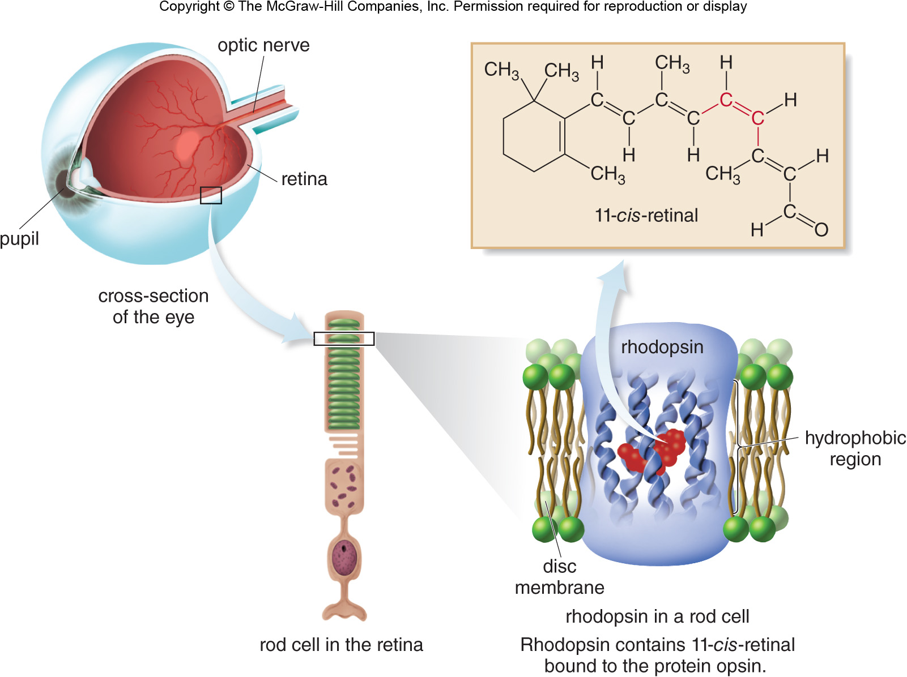
16.7 Focus on the Human Body (4)
The Chemistry of Vision

Slide 40
Focus on the Human Body
The Chemistry of Vision

Slide 41
16.8 Acetal Formation (1)
Aldehydes undergo addition reactions with alcohols
to form hemiacetals and acetals (in the presence of H₂SO₄).

Slide 42
16.8 Acetal Formation (2)
Acetals and Hemiacetals
Addition of one molecule of alcohol to an aldehyde forms a hemiacetal.
A hemiacetal will react with a second molecule of alcohol to form an acetal.

Slide 43
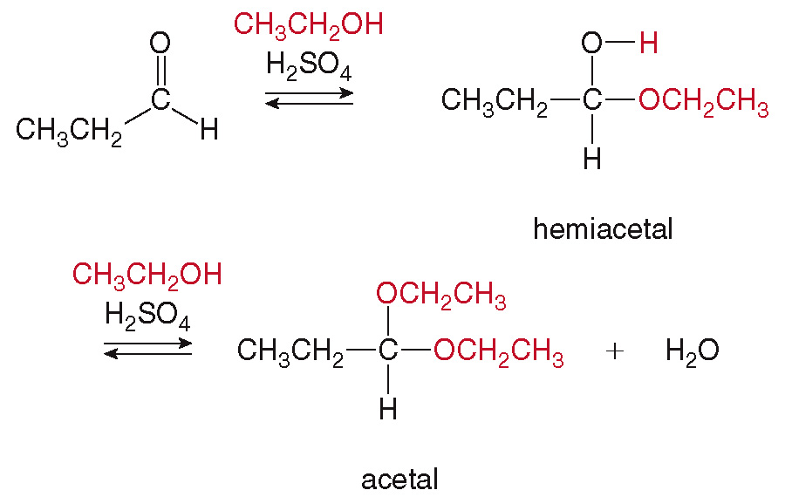
16.8 Acetal Formation (3)
Acetals and Hemiacetals
An example of acetal formation using ethanol as the added alcohol:

Slide 44
16.8 Acetal Formation (4)
Cyclic Hemiacetals
Cyclic hemiacetals containing 5 or 6 membered rings are stable compounds.

Slide 45
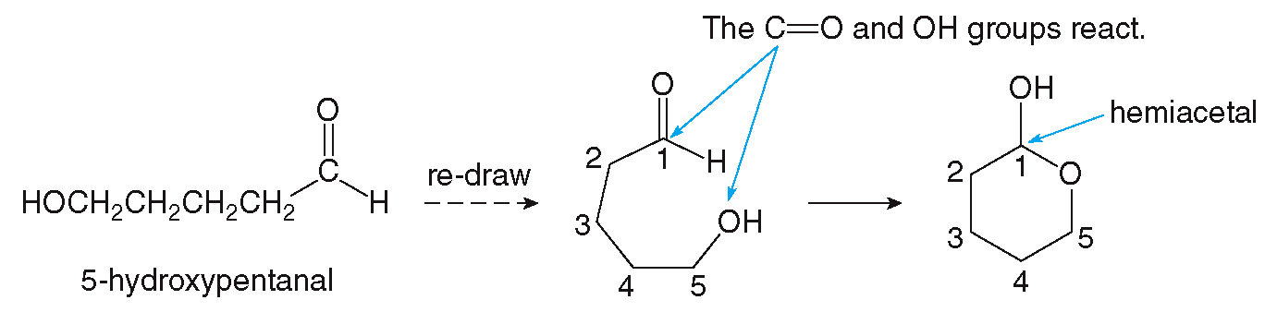
16.8 Acetal Formation (5)
Cyclic Hemiacetals
They are formed by an intramolecular reaction of a compound that contains both an OH group and an aldehyde.

Slide 46
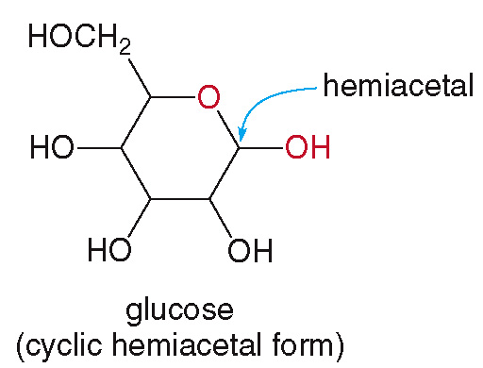
16.8 Acetal Formation (6)
Cyclic Hemiacetals
The most common simple carbohydrate, glucose, exists predominantly as a cyclic hemiacetal.

Slide 47
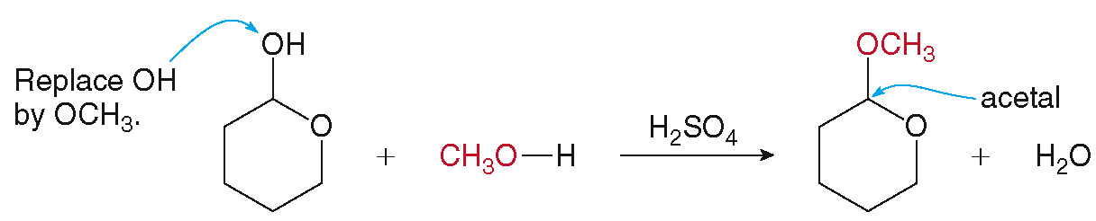
16.8 Acetal Formation (7)
Cyclic Hemiacetals
Cyclic hemiacetals are converted to cyclic acetals by reaction with another alcohol.

Slide 48
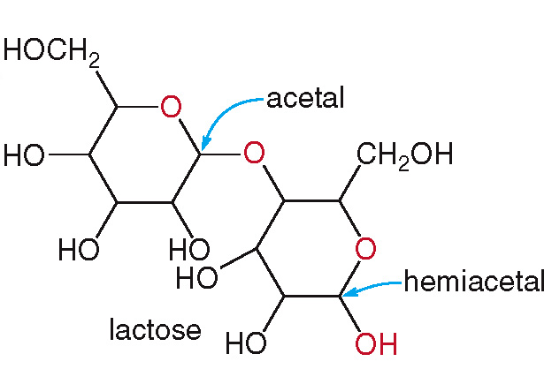
16.8 Acetal Formation (8)
Cyclic Hemiacetals
Lactose, the main carbohydrate in milk, is composed of both a cyclic hemiacetal and a cyclic acetal.

Slide 49
16.8 Acetal Formation (9)
Acetal Hydrolysis
Acetals can be converted back to aldehydes and alcohols by hydrolysis.

Slide 50
16.8 Acetal Formation (10)
Acetal Hydrolysis

