Slide 1
Equal Employment Opportunity Plan 2026-2029 Overview for DAGS Senate
EEO Plan Cycle: 2026–2029
Presented by Tony Brown, Director, Equity and Compliance
Human Resources

Slide 2
Purpose of the EEO Plan
Required under California Title 5 regulations
Ensures all qualified individuals have equal access to employment opportunities
Supports a diverse and inclusive workforce
Aligns hiring practices with equity and nondiscrimination laws

Slide 3
What the EEO Plan Includes
Workforce demographic analysis
Monitoring of applicant pools and hiring outcomes
Complaint procedures for discrimination or Title 5 violations
Training requirements for hiring committees
Strategies to address underrepresentation

Slide 4
Governance and Responsibility
Board of Trustees adopts the EEO Plan
Chancellor responsible for overall implementation
Vice Chancellor of Human Resources serves as EEO Officer
Diversity & Equity Advisory Committee (DDEAC) advises on implementation

Slide 5
Role of Human Resources
Monitor applicant pools and workforce demographics
01
Conduct adverse impact analysis (80% rule)
02
Provide hiring committee EEO training
03
Investigate complaints and ensure compliance with Title 5
04
Report progress to leadership and advisory committees
05

Slide 6
Role of Diversity and Equity Advisory Committee (DDEAC)
Supports implementation of the EEO Plan
Monitors progress toward equity goals
Recommends strategies for recruitment, hiring, and retention
Meets at least Fall and Spring each year

Slide 7
Plan Timeline (2026–2029 Cycle)
Draft Plan Development: 2025–2026
Submission to CCC Chancellor’s Office: At least 90 days before Board adoption
Board Adoption Target: 2026
Plan Implementation Period: 2026–2029
Required Plan Review: Every 3 years

Slide 8
Ongoing Monitoring and Milestones
Annual workforce demographic review by HR
Annual outreach to community recruitment organizations
Continuous monitoring of applicant pools and hiring outcomes
Hiring committee training every 2 years for participants
Complaint investigations completed within 90 days when possible

Slide 9
Consultation and Communication
HR will provide updates on EEO Plan implementation
Consultation with DAGS Senate as outlined in the Plan
Updates shared through DDEAC and District governance
Feedback from employee groups informs future revisions

Slide 10
Role of the DAGS Senate in EEO Plan Consultation
The EEO Plan states that Human Resources will keep DAGS Senate informed through consultation.
HR will provide updates on the development, implementation, and review of the EEO Plan.
DAGS Senate may provide feedback on hiring practices, equity strategies, and workplace climate.
Input from DAGS helps ensure the Plan reflects the experiences of staff across the district.
Consultation supports transparency and shared governance in advancing equal employment opportunity.

Slide 11
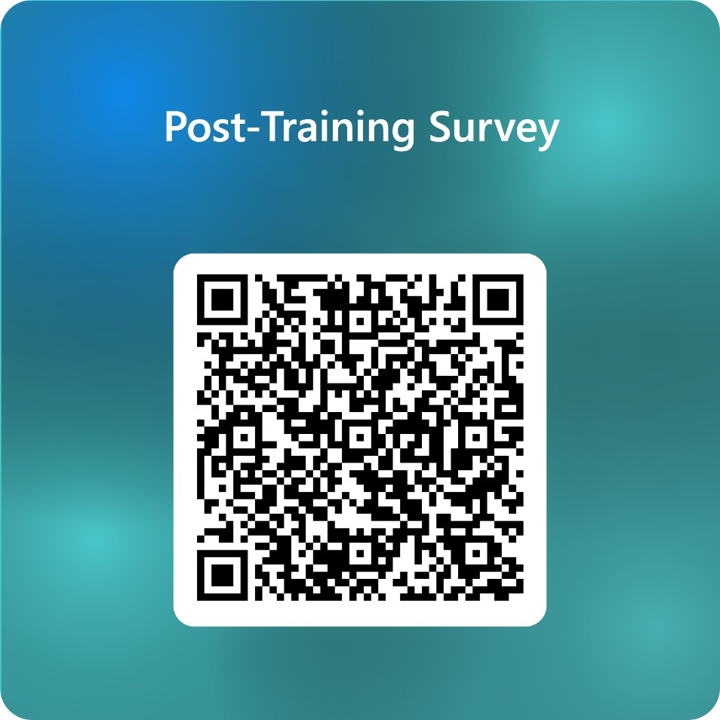
Questions/Comments

